Slide 1
Lecture 8
Consequences of Network Models of Cities
8.1 Predictive Consequences of Urban Scaling
IUS 3.3
©Luís M. A. Bettencourt 2024 @BettencourtLuis bettencourt@uchicago.edu

Slide 2




IUS Fig 3.10
A socioeconomic network of diverse people
Notes:
Ok, so let’s imagine a social network of millions of diverse people…

Slide 3







IUS Fig 3.10
…can be abstracted in terms of an “ego-network”
Notes:
It helps for many purposes to concentrate on one person at the time (their ego network)

Slide 4

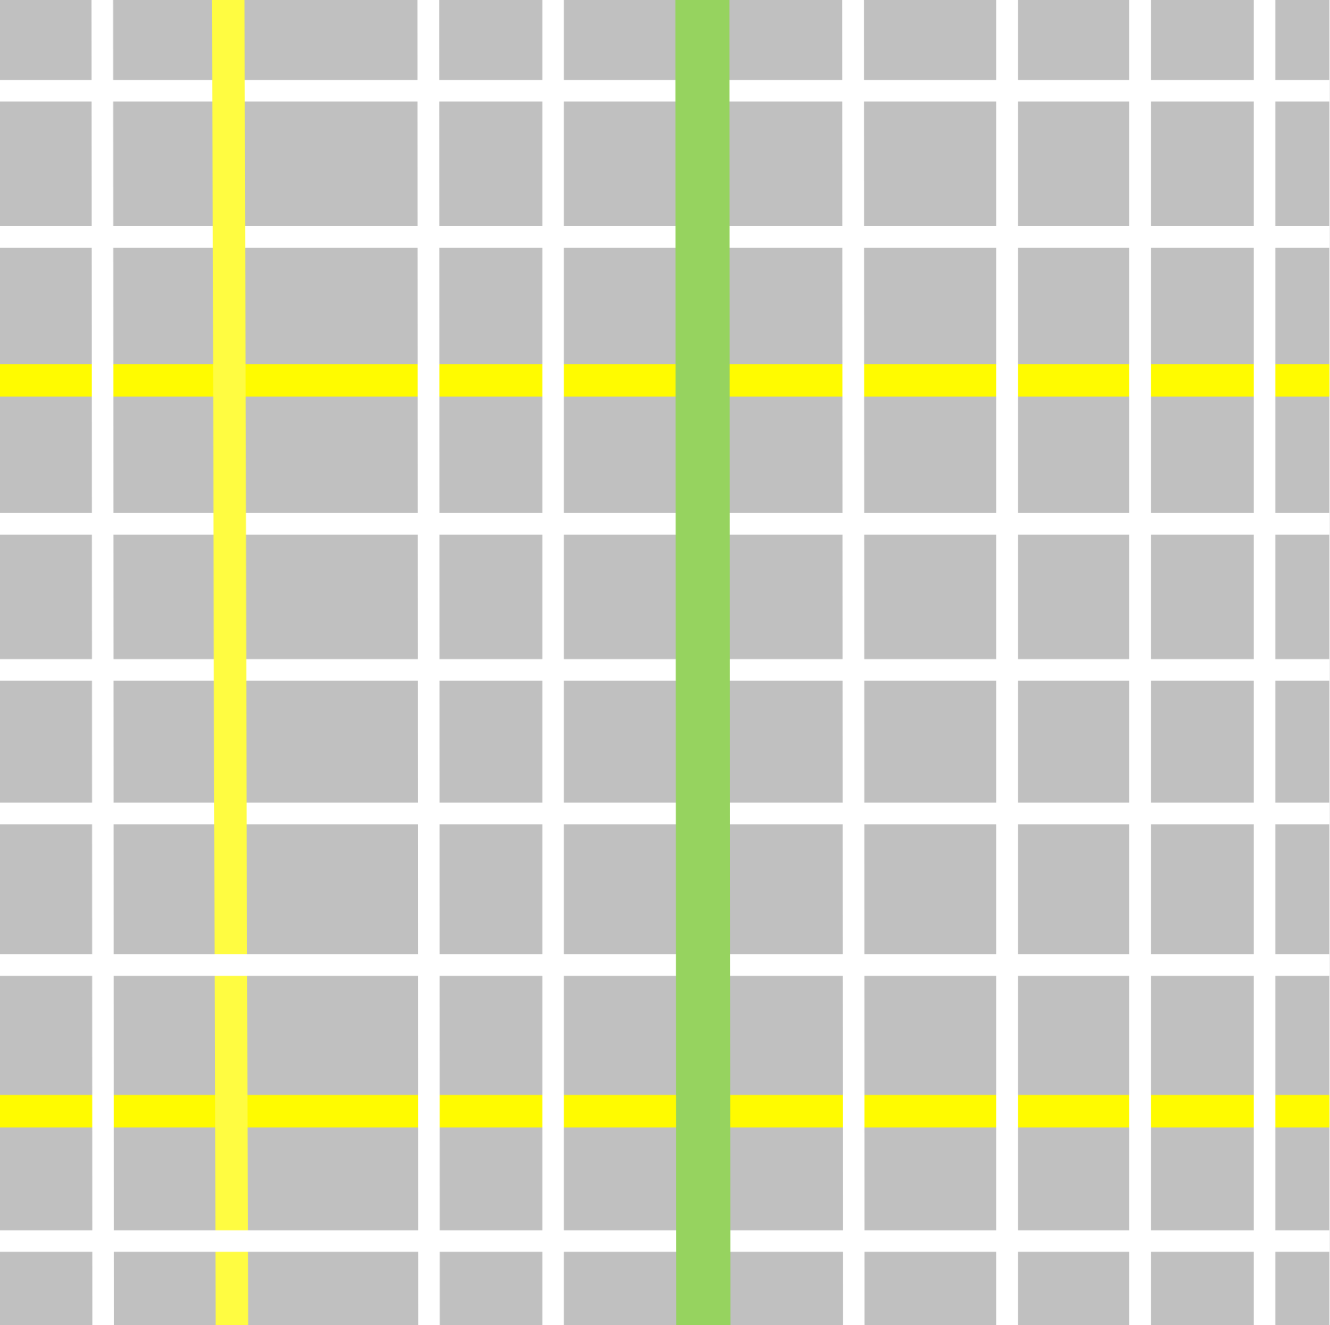

Health
Love
Money
Education
Fun
Food
Services
…
IUS Fig 3.10
…which is embedded in spacetime via life paths (time geography)
Notes:
And let’s put these interactions in the space-time of the city. To do this, we introduce a beautiful (and intuitive) concept from ‘time geography’ called the life path (this is the person’s trajectory in (urban) space-time; in physics the same concept is known as the worldline). Every one has a worldline, and big tech companies will keep track of yours, if you let them. This is not an abstract concept: you can measure life paths, e.g. with mobile devices.

Slide 5

Health
Love
Money
Education
Fun
Food
Services
…
IUS Fig 3.10
…which is embedded in spacetime via life paths, which meet more events in larger, denser, more heterogeneous cities
Notes:
The idea now, as you go to a larger city is that with the same effort, there are more people and things to do around, and the rates of socioeconomic interaction (and production) increase to the extent that the (built space) density of interactions increases. In addition, as we shall see, the infrastructure changes to include faster and larger volume flows, such as via highways and subways, and houses tend to get a little smaller (more on that soon). This sequence of pictures is essential what we will propose as a theory of urban scaling.

Slide 6
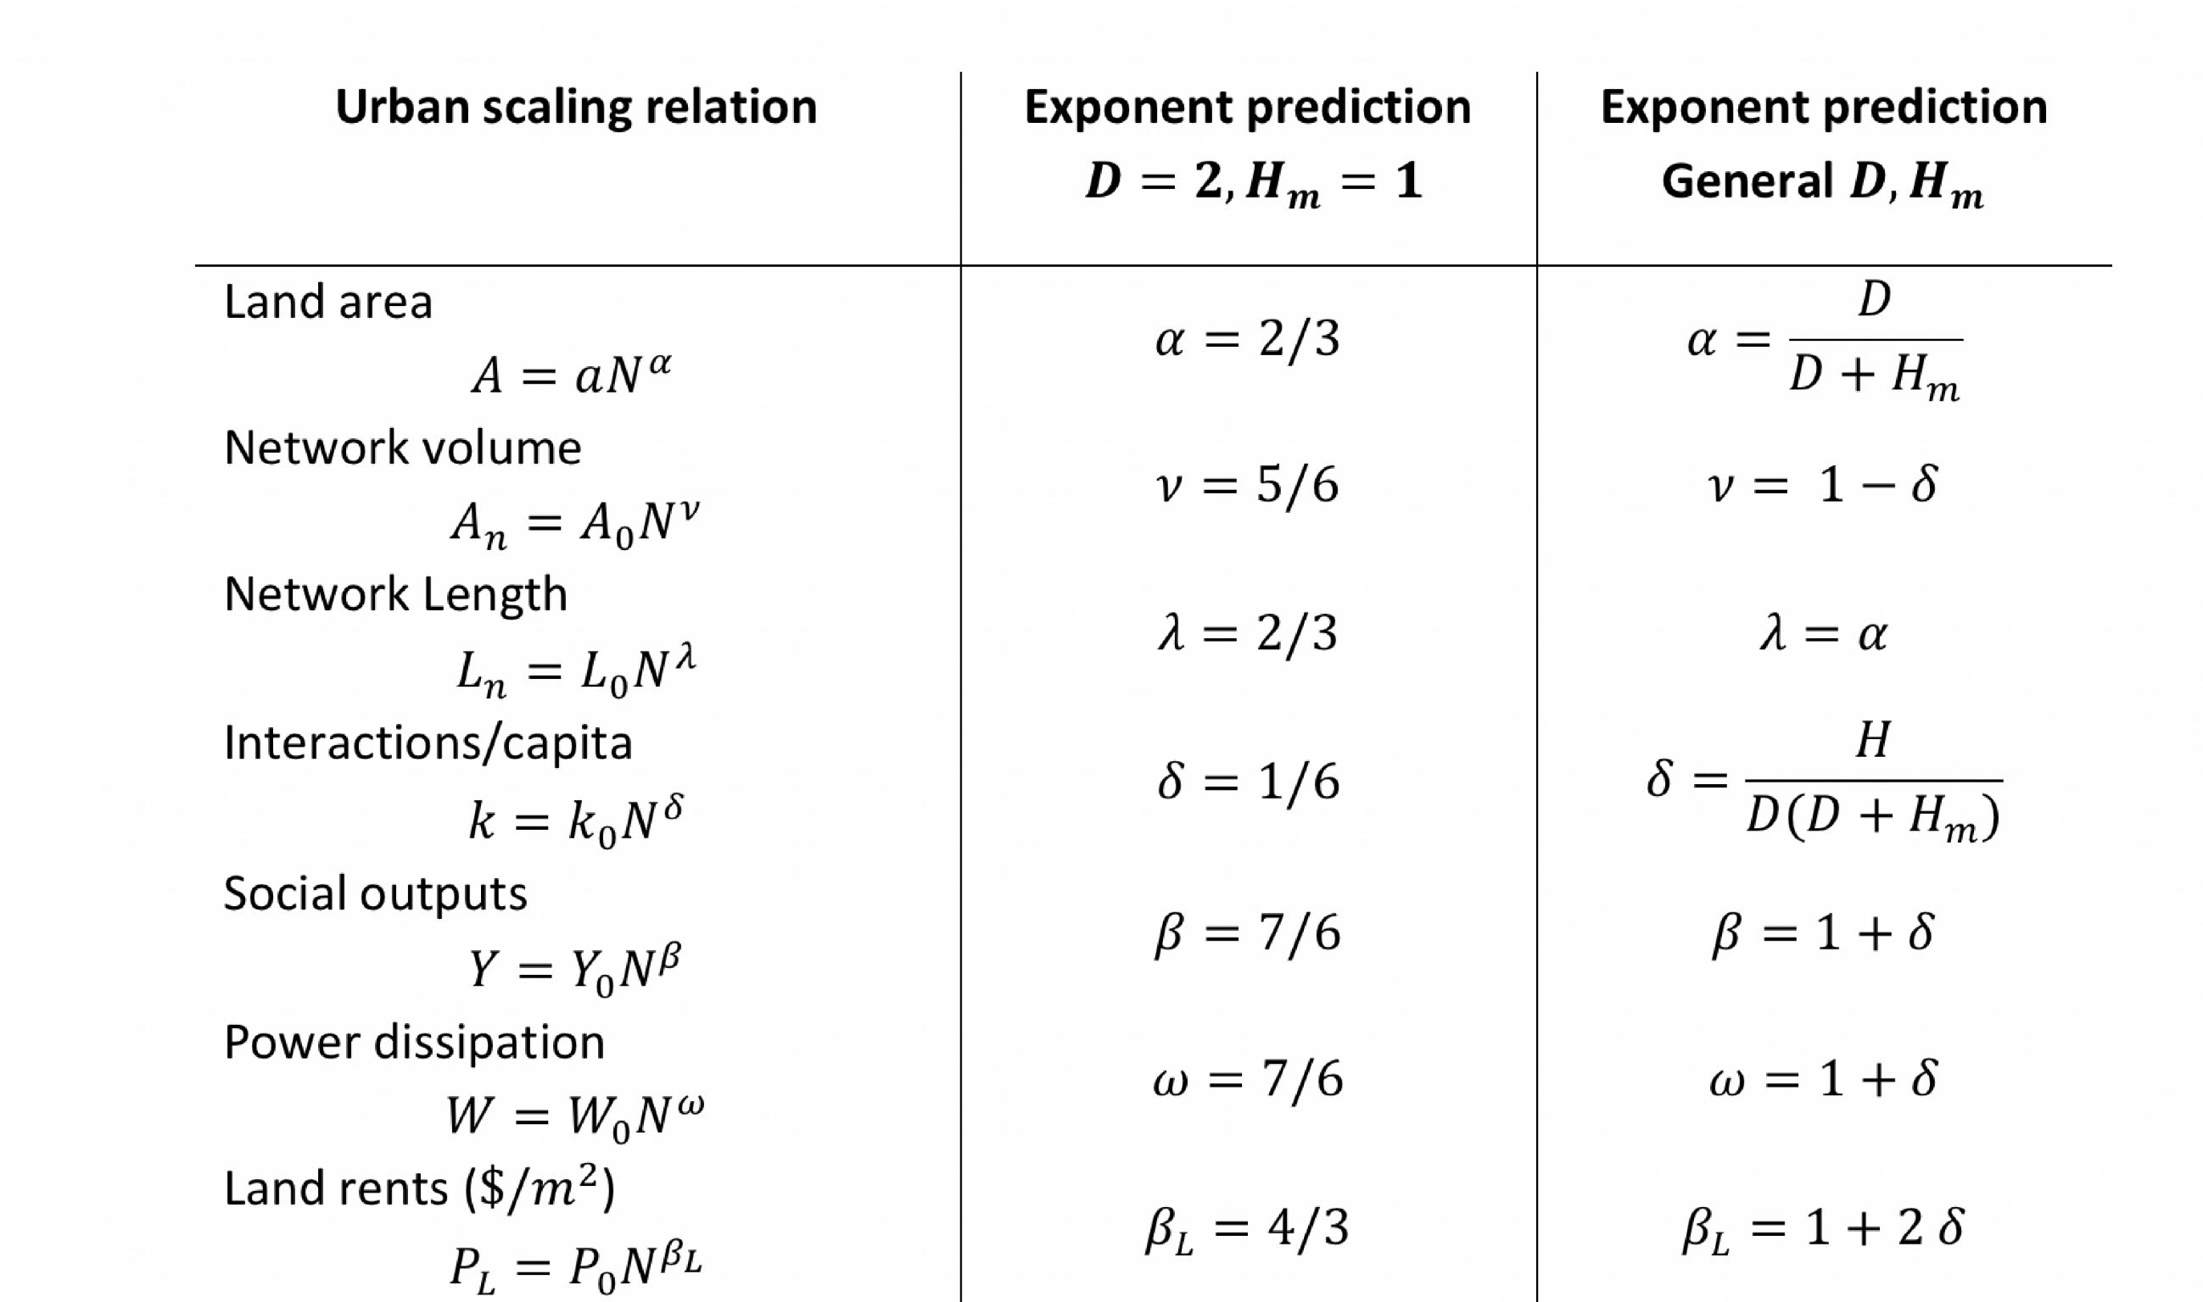
Many quantitative predictions + general consequences
cities in
higher dimensions
m
Summary of Urban Scaling relations and exponent predictions for various important quantities. Note that agglomeration effects vanish when $H_{m}→0$ because then people remain spatially separated social networks fail to emerge (we will look at internet quantities later).
Notes:
This summarizes the results for the scaling exponents from urban scaling theory, from the previous module.

Slide 7
Besides predictions for scaling of all these quantities…
There are a number of very interesting combinations and ratios:
The ratio of built volume to total area of cities
2. The depth of social networks in cities vs the size of the entire population
3. The “price” of land (land rents): or the rate of money exchanged per land area
4. The ratio of land rents and incomes and building heights
-
-
Notes:
There are many other interesting predictions that follow from urban scaling theory.

Slide 8
Landscapes of Infrastructure
$$A_{n}/A∼N^{δ}$$
Greater infrastructure network volume per unit area with city size, especially in city centers

Slide 9

Master/Trunk infrastructure gets enormous

Slide 10

infrastructure networks must push into the third dimension
credit: MacLean

Slide 11
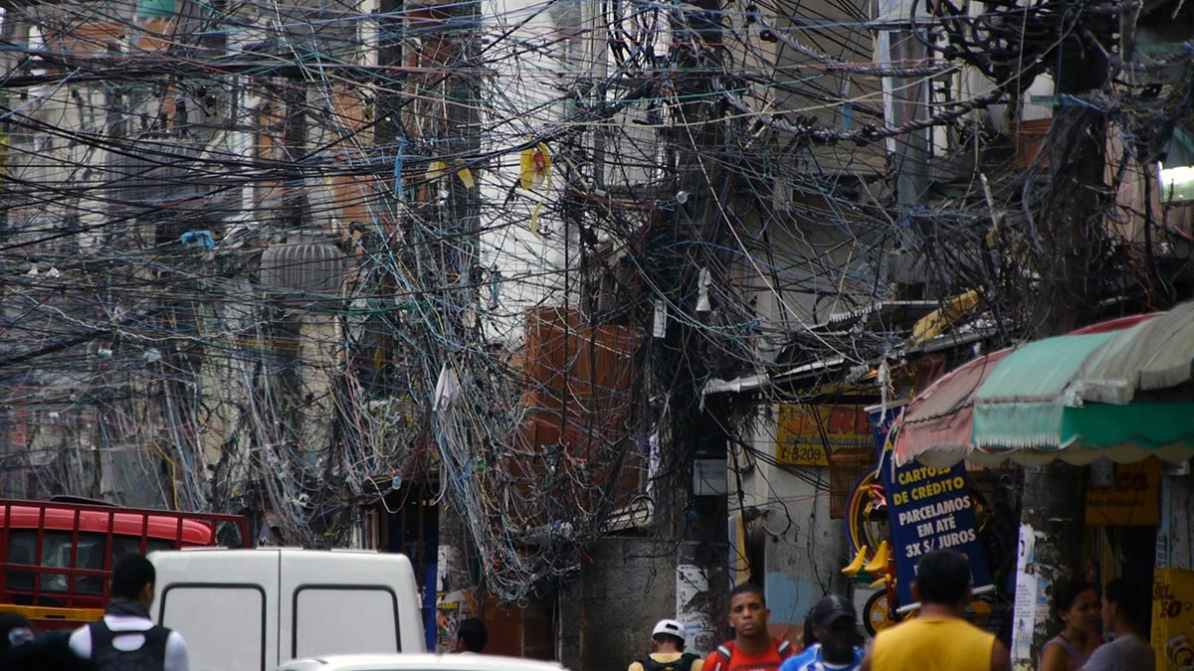
infrastructure networks take over many urban spaces
credit: Robert Stone

Slide 12
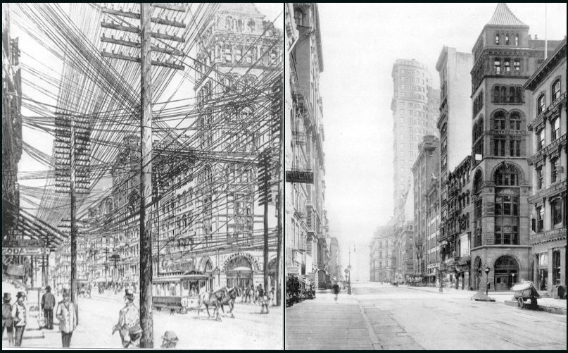
NYC before and after ice storm and burying of electrical cables
1890s New York City
credit: www.loper-os.org
And must go into the third dimension, above or below ground to leave space for people

Slide 13
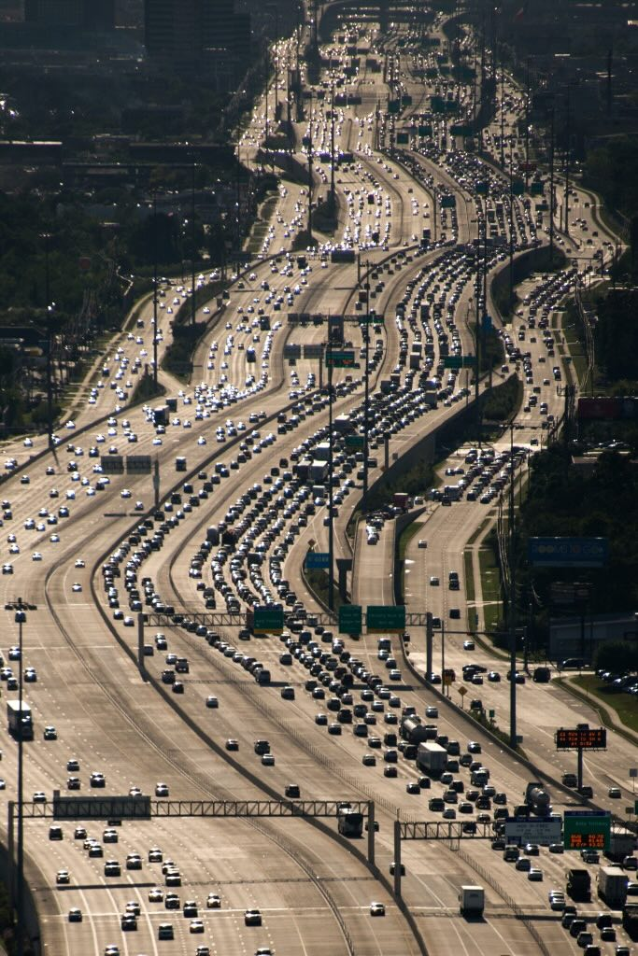
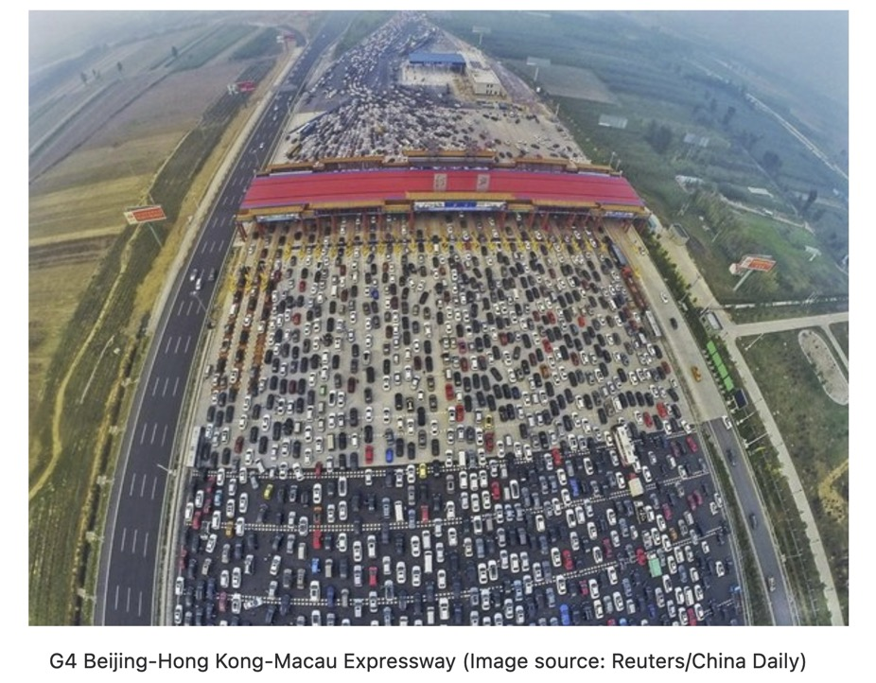
World’s Widest Highways
IH-10 in Houston TX
what happens to width when speeds are lower?

Slide 14
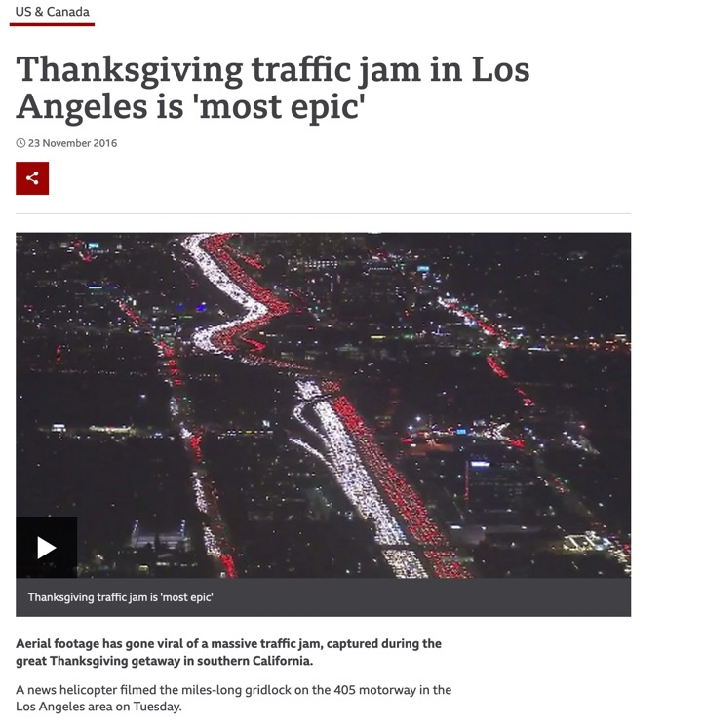
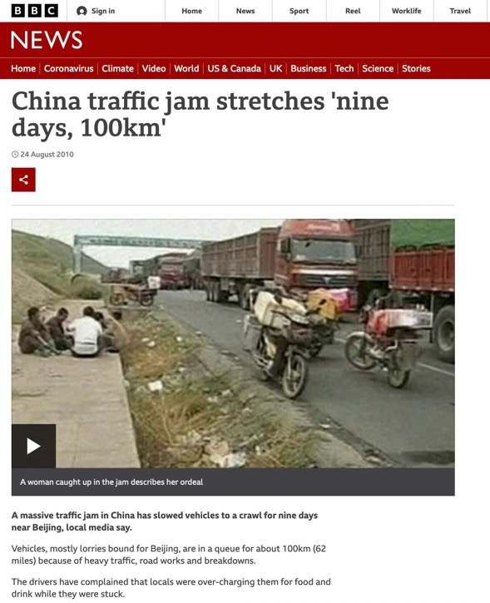
World’s Worst Traffic Jams
mostly in large developing cities

Slide 15
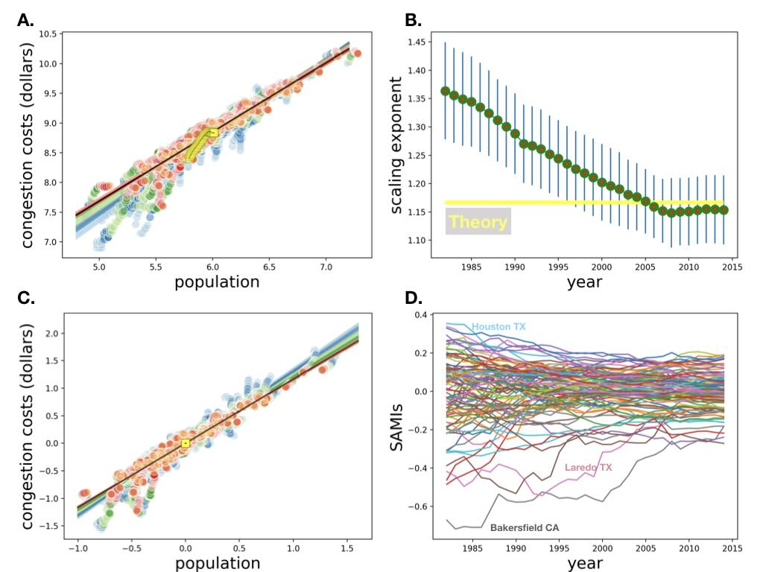
different colors are different years
different colors are different years
https://royalsocietypublishing.org/doi/pdf/10.1098/rsif.2019.0846
Notes:
Congestion (these are estimated extra costs of congestion) are superlinear and a fixed fraction of GDP as predicted.

Slide 16
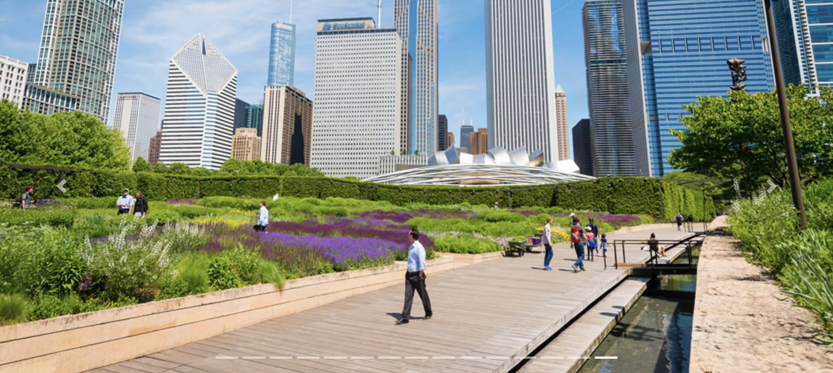
Frank Gehry: Jay Pritzker Pavillion

Slide 17
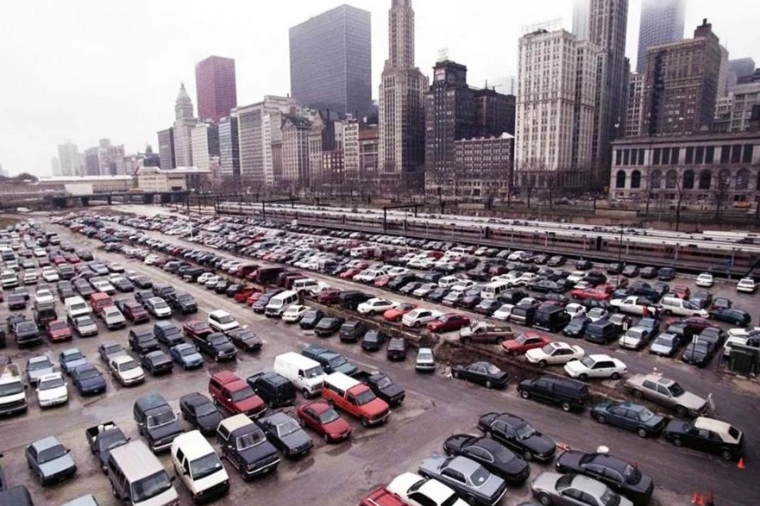
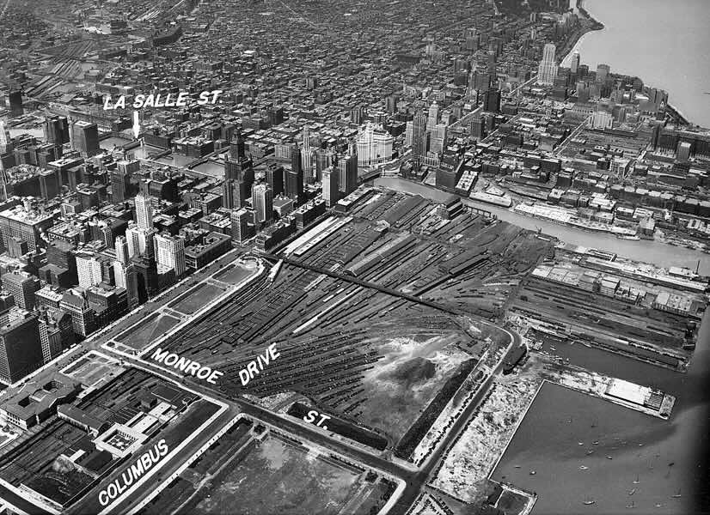
Before Millennium Park

Slide 18
building heights
$$GDP_{pc}/a_{n}∼N^{2δ}$$
Land rents increase faster than incomes!!
building heights
$$∼N^{δ}$$
larger cities get rising skylines

Slide 19
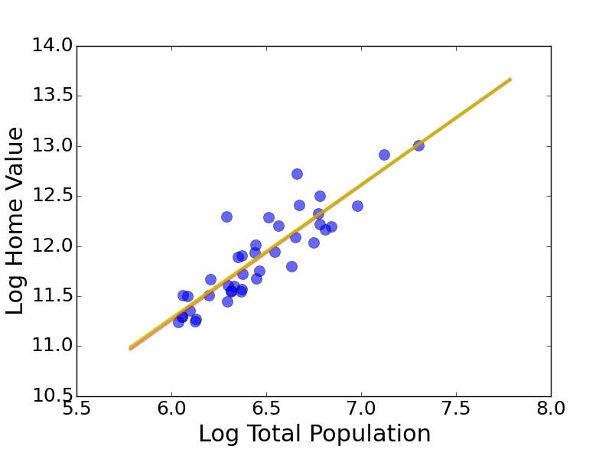

Home Value US Metros
Paris
San Francisco
London
Milan
San Jose
Madrid
Berlin
elasticity=33%
Home Value~(Population)^{1.33}
Housing is never affordable in large cities

Slide 20
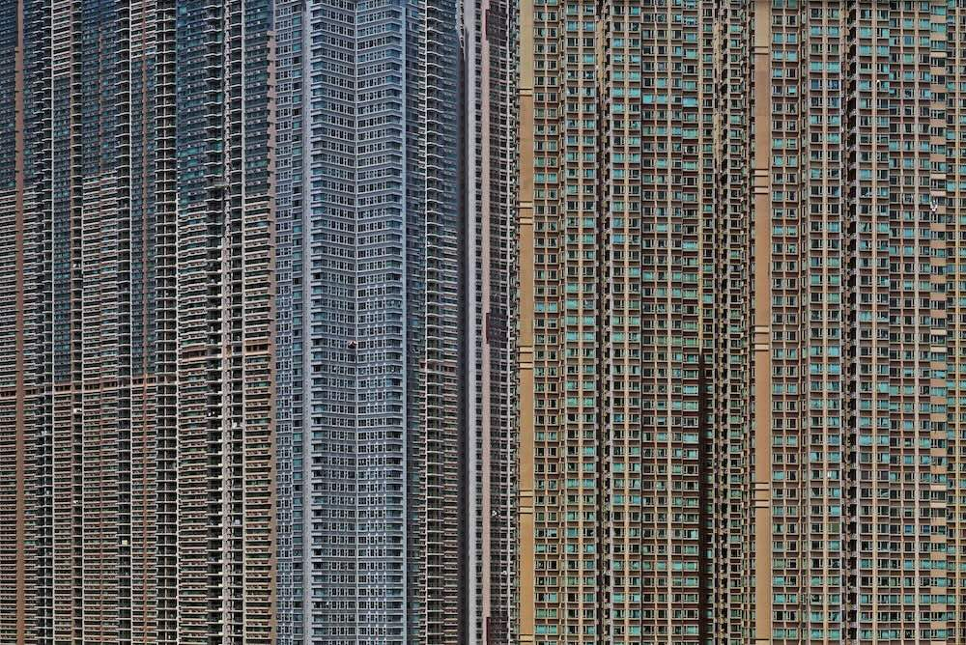
why?
Hong Kong
credit:Guardian

Slide 21
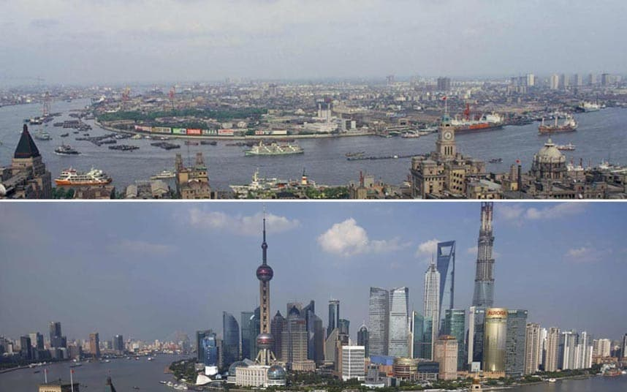
credit: telegraph
Notes:
Buildings get bigger and taller in larger cities: is this predictable?

Slide 22
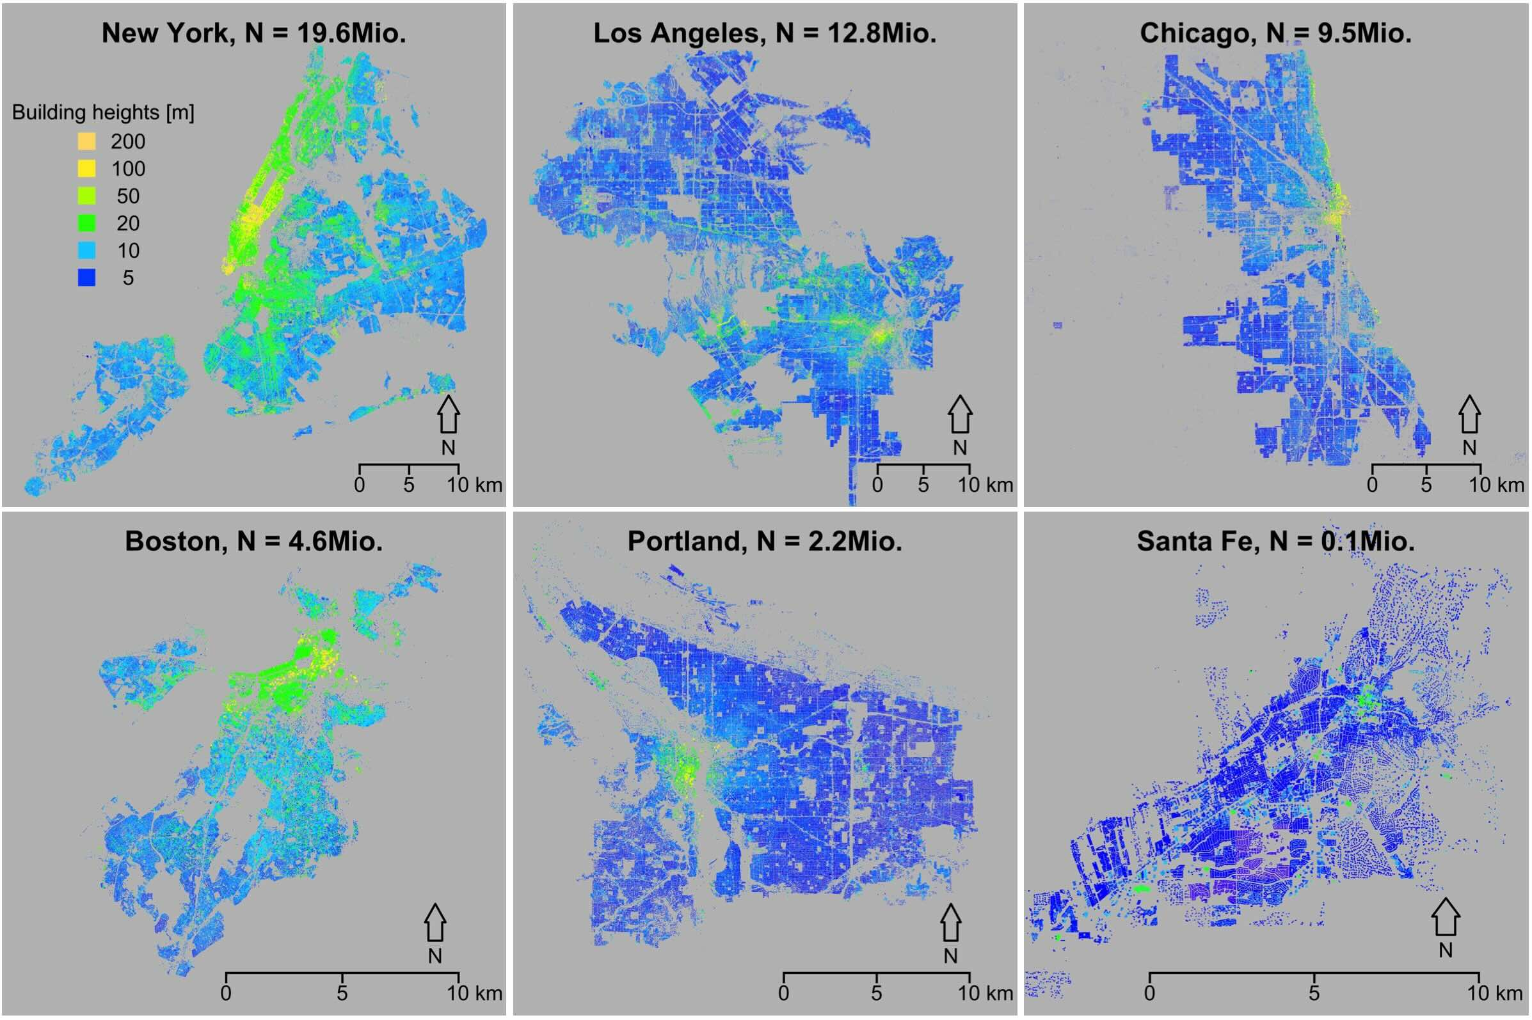
data from LiDAR
Schlaepfer, Lee, Bettencourt (2016)
Urban Skylines: building heights and shapes as measures of city size

Slide 23
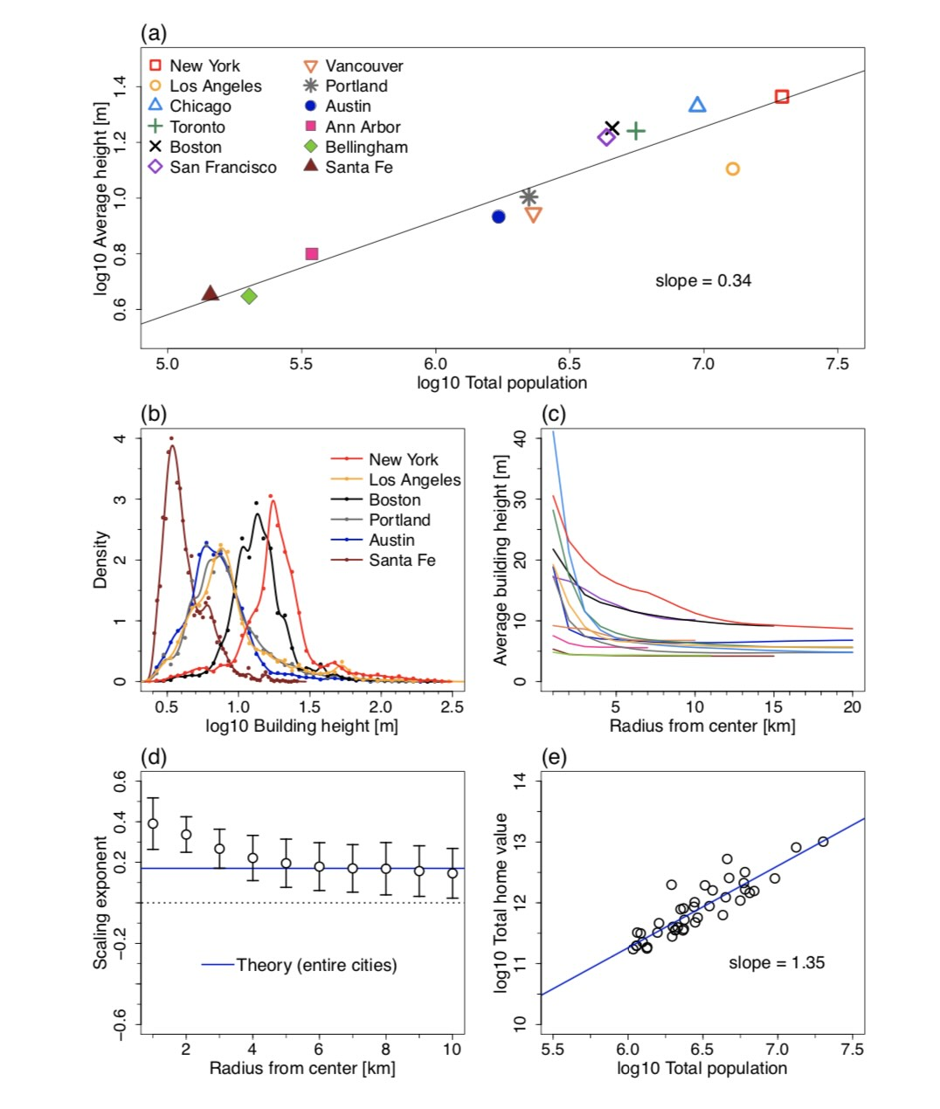

Slide 24
Characterizing (building) shapes
Simplest shape:
More general shape:
$$V_{b}=l_{c}^{3}$$
Cuboid: with height $h_{b}$ and footprint $l_{b}^{2}$
$$l_{c}=V_{b}^{1/3}$$
$$V_{b}=l_{n}^{2}h_{b}$$
$$a_{A/V}=\frac{6}{l_{c}}\left(\frac{x_{b}^{-2/3}+2x_{b}^{1/3}}{3}\right)$$
cube
$$A_{b}=6l_{c}^{2}$$
$$l_{c}$$
$$A_{b}=2l_{b}^{2}+4h_{b}l_{b}$$
$$x_{b}=\frac{h_{b}}{l_{b}}$$
Skyscraper
$$a_{A/V}=6/l_{c}$$
$$x_{b}=1$$
minimizes $a_{A/V}$
Flat sheet (warehouse)
Energy Use (climate control)
$$\frac{ΔE}{Δt}=μ_{b}A_{b}ΔT$$
$$N_{b}=C(h_{b})\frac{l_{b}^{2}}{a_{f}}\frac{h_{b}}{h_{0}}=\frac{V_{b}}{v_{v}}$$
$$\frac{1}{N_{b}}\frac{ΔE}{Δt}=a_{A/V}μ_{b}v_{b}ΔT$$
temperature difference
Power consumption
Building max occupancy
Energy use/capita (efficiency)

Slide 25
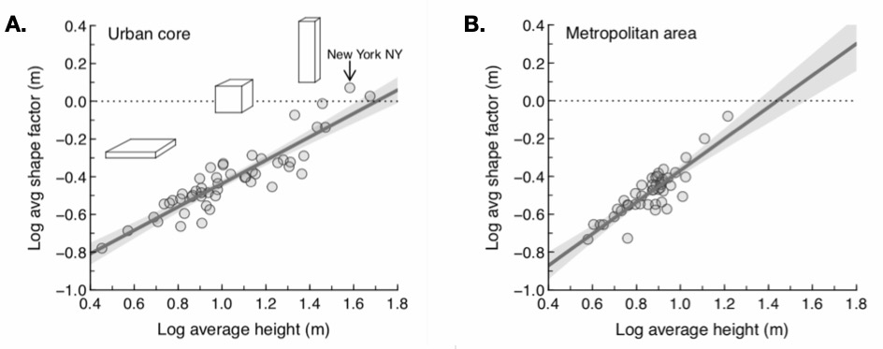
$$x=1$$
Heigh and footprint area are correlated

Slide 26
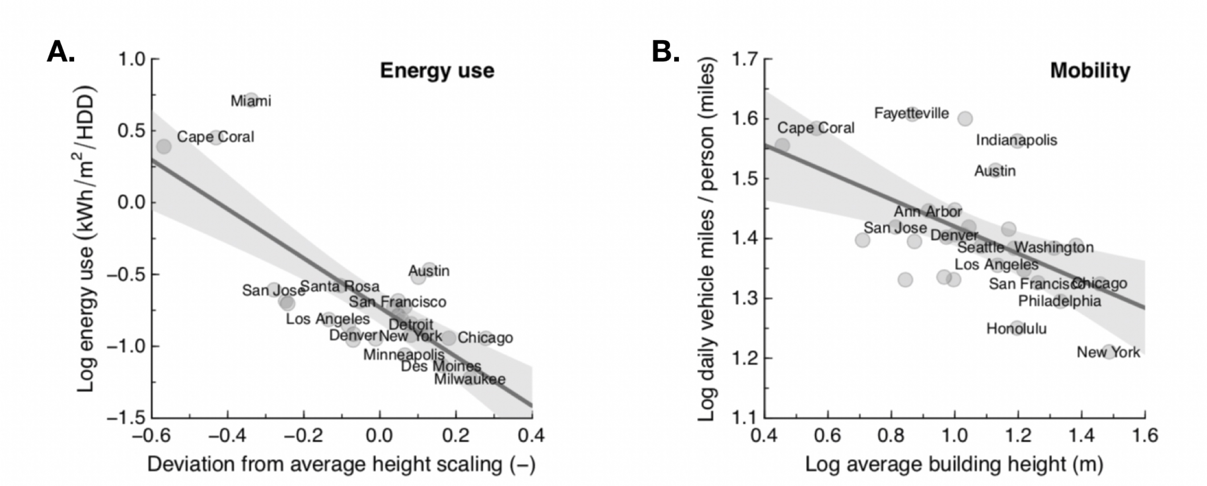
Higher buildings lead to savings in energy use and mobility

Slide 27
Social Networks get denser
average connectivity per capita:
$$∼N^{δ}$$

Slide 28
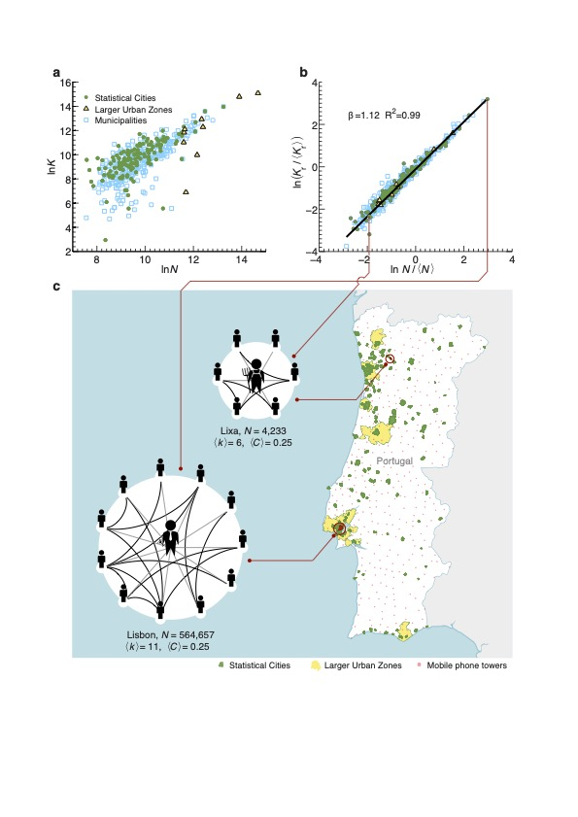
Urban cellphone networks
𝛽 = 1.12-1.19
in agreement with theory.
Network clustering
is preserved:
same sense of
community
in town and country!
Schläpfer et al, 2014
Notes:
Urban social networks from cell phones scale as expected

Slide 29
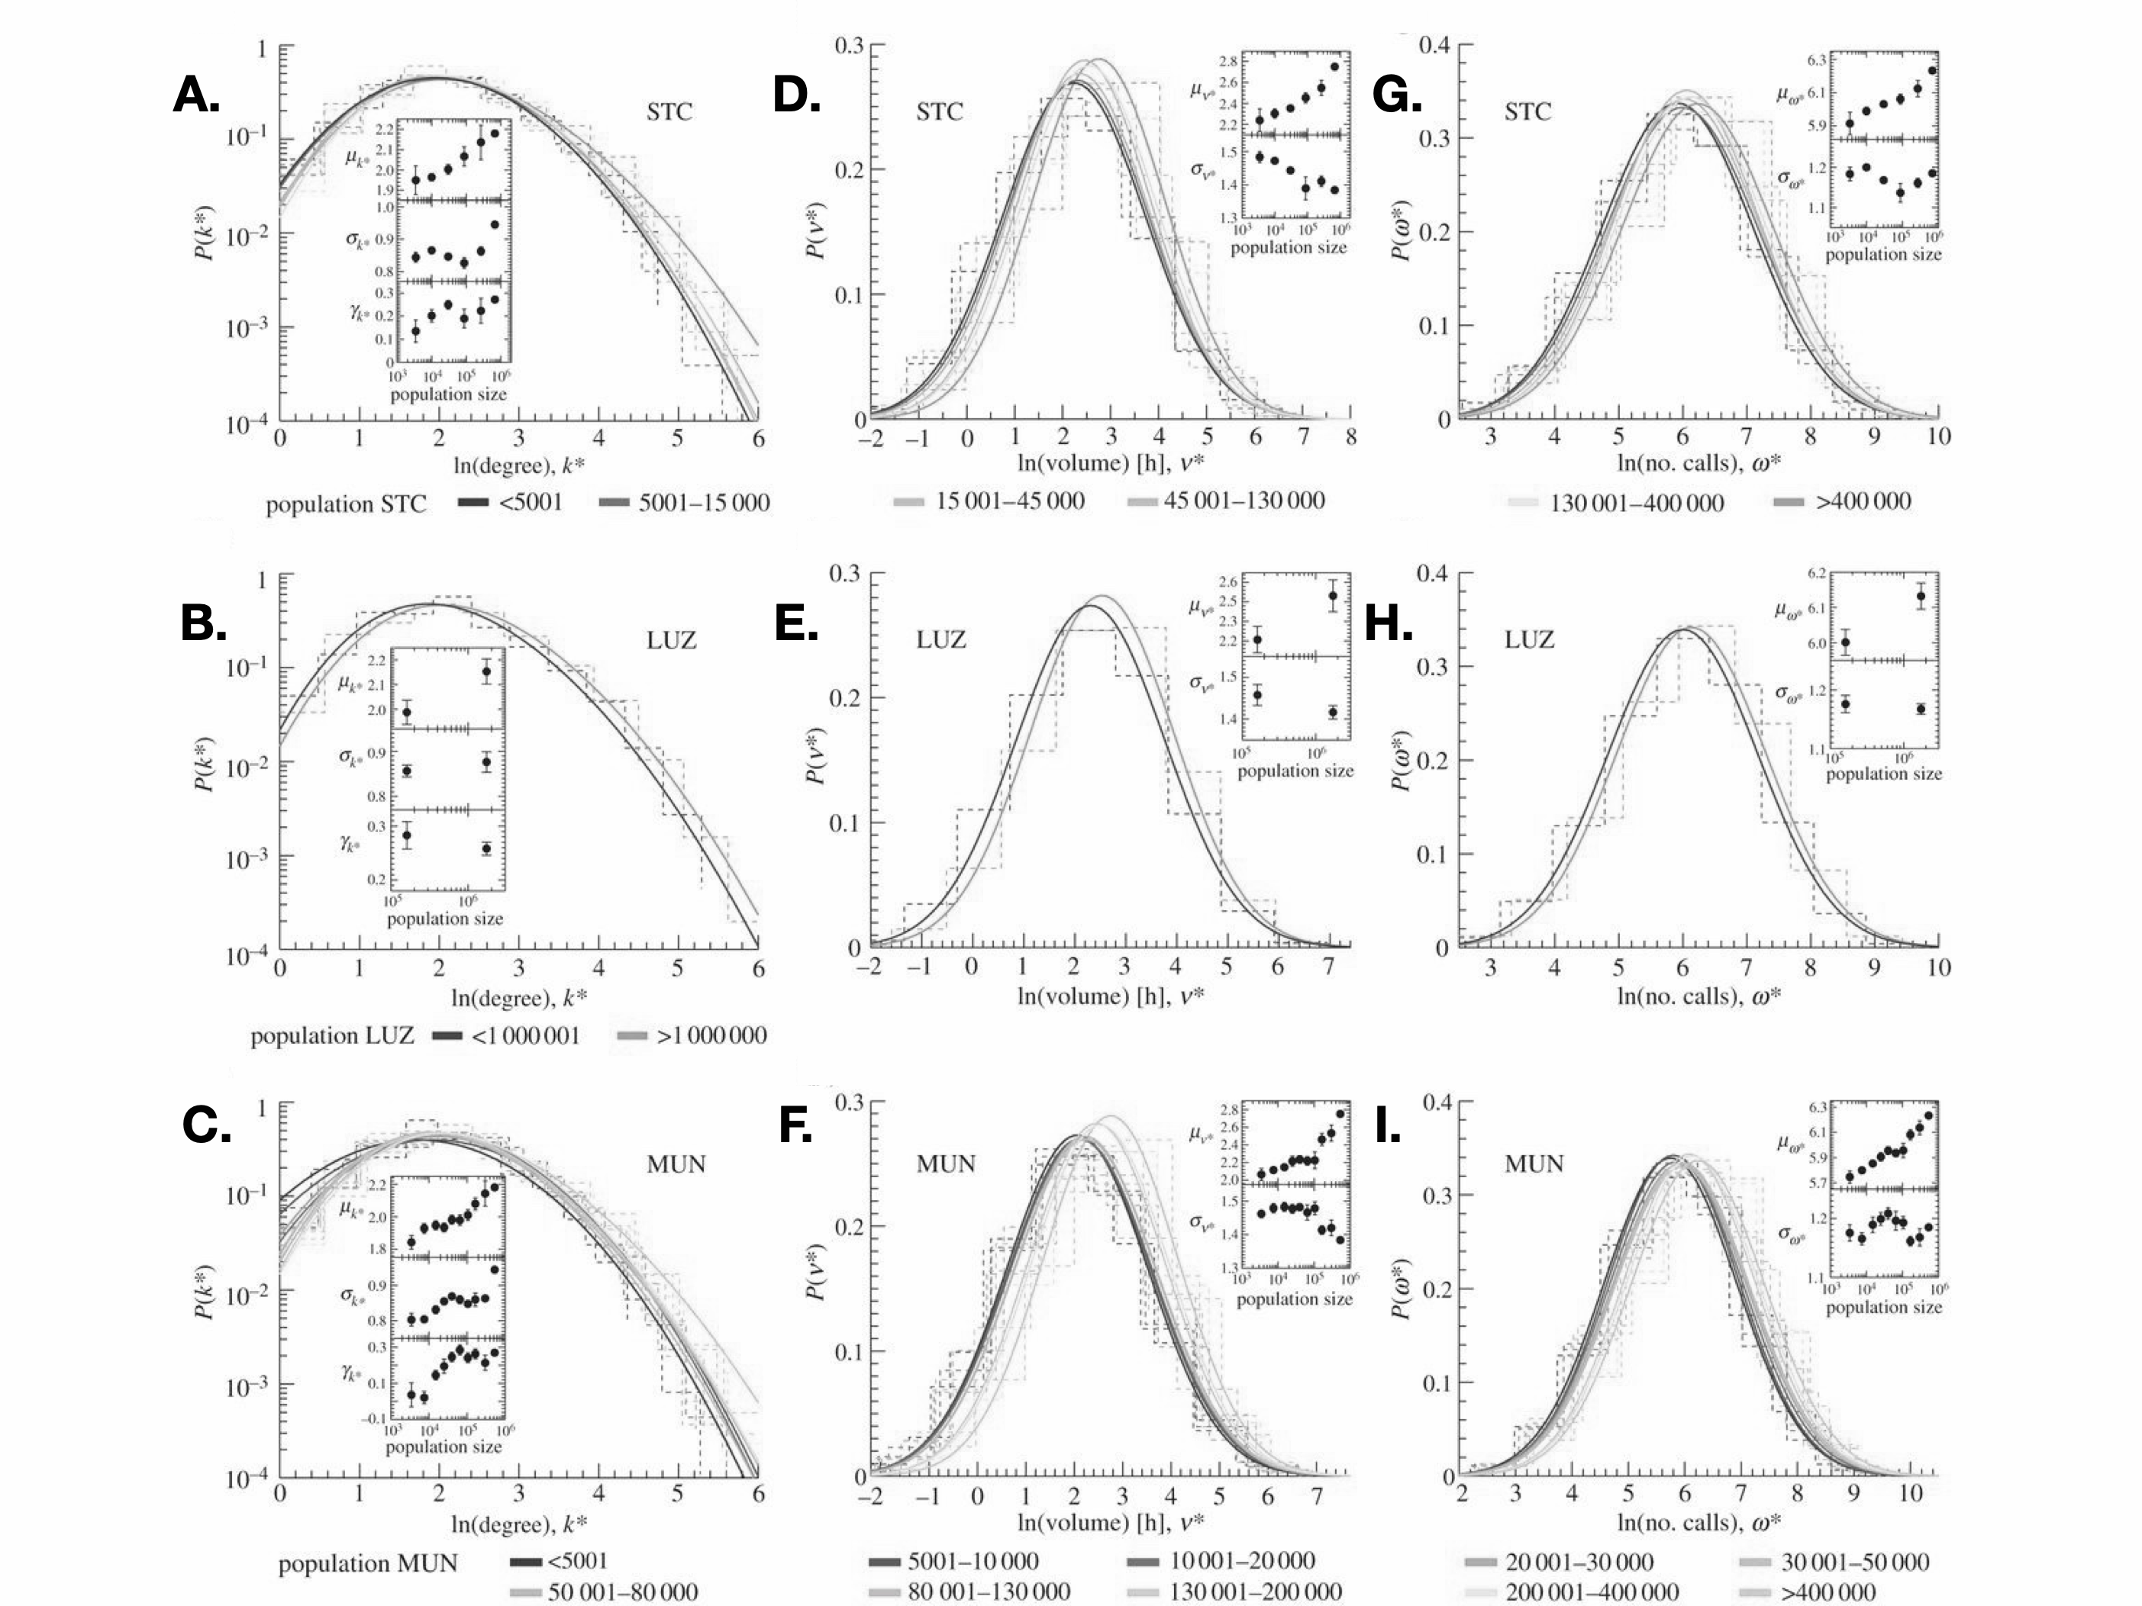
10 connections
From cellphones” distribution of degree is very wide (lognormal)
500 connections
Notes:
But we can also observe their statistics (which is approximately lognormal)

Slide 30
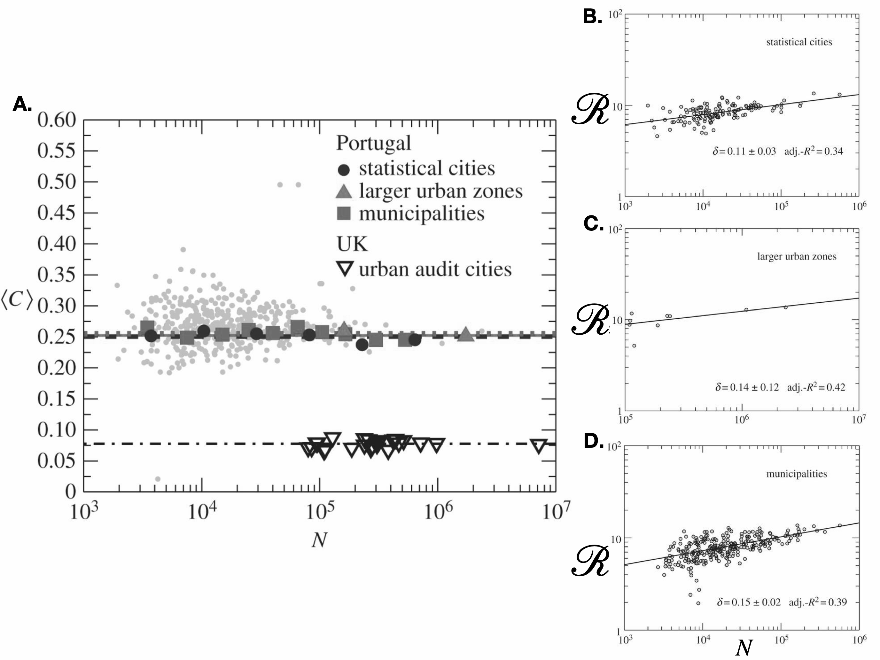
How many of your friends are mutual friends ?
clustering coefficient
Contagion Dynamics
scales superlinearly
with population size
https://royalsocietypublishing.org/doi/full/10.1098/rsif.2013.0789
Notes:
Contagion (and the reproductive number of infectious diseases) also scale superlinearly (see book for calculation).

Slide 31
Contagious Diseases and Information spread faster in larger cities
average connectivity per capita:
$$k(N)∼N^{δ}$$

Slide 32
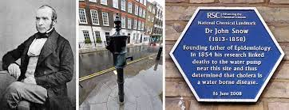
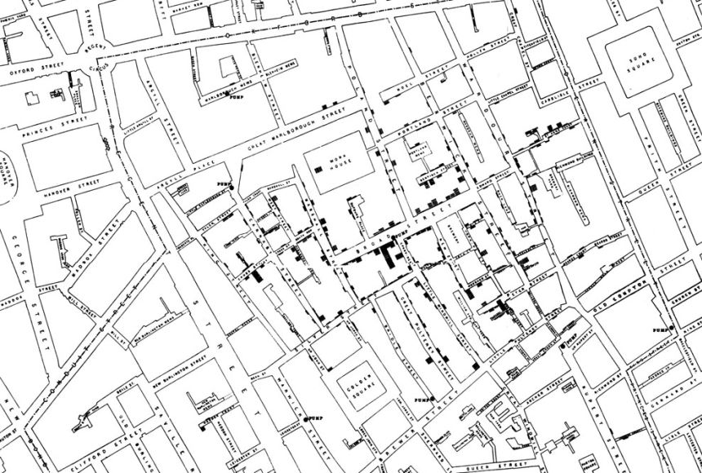
beginning of modern medicine = beginning of modern urban planning
Science
Spread
Policy
Implementation
London 1854
Third cholera pandemic
5.5% death rate in Chicago

Slide 33
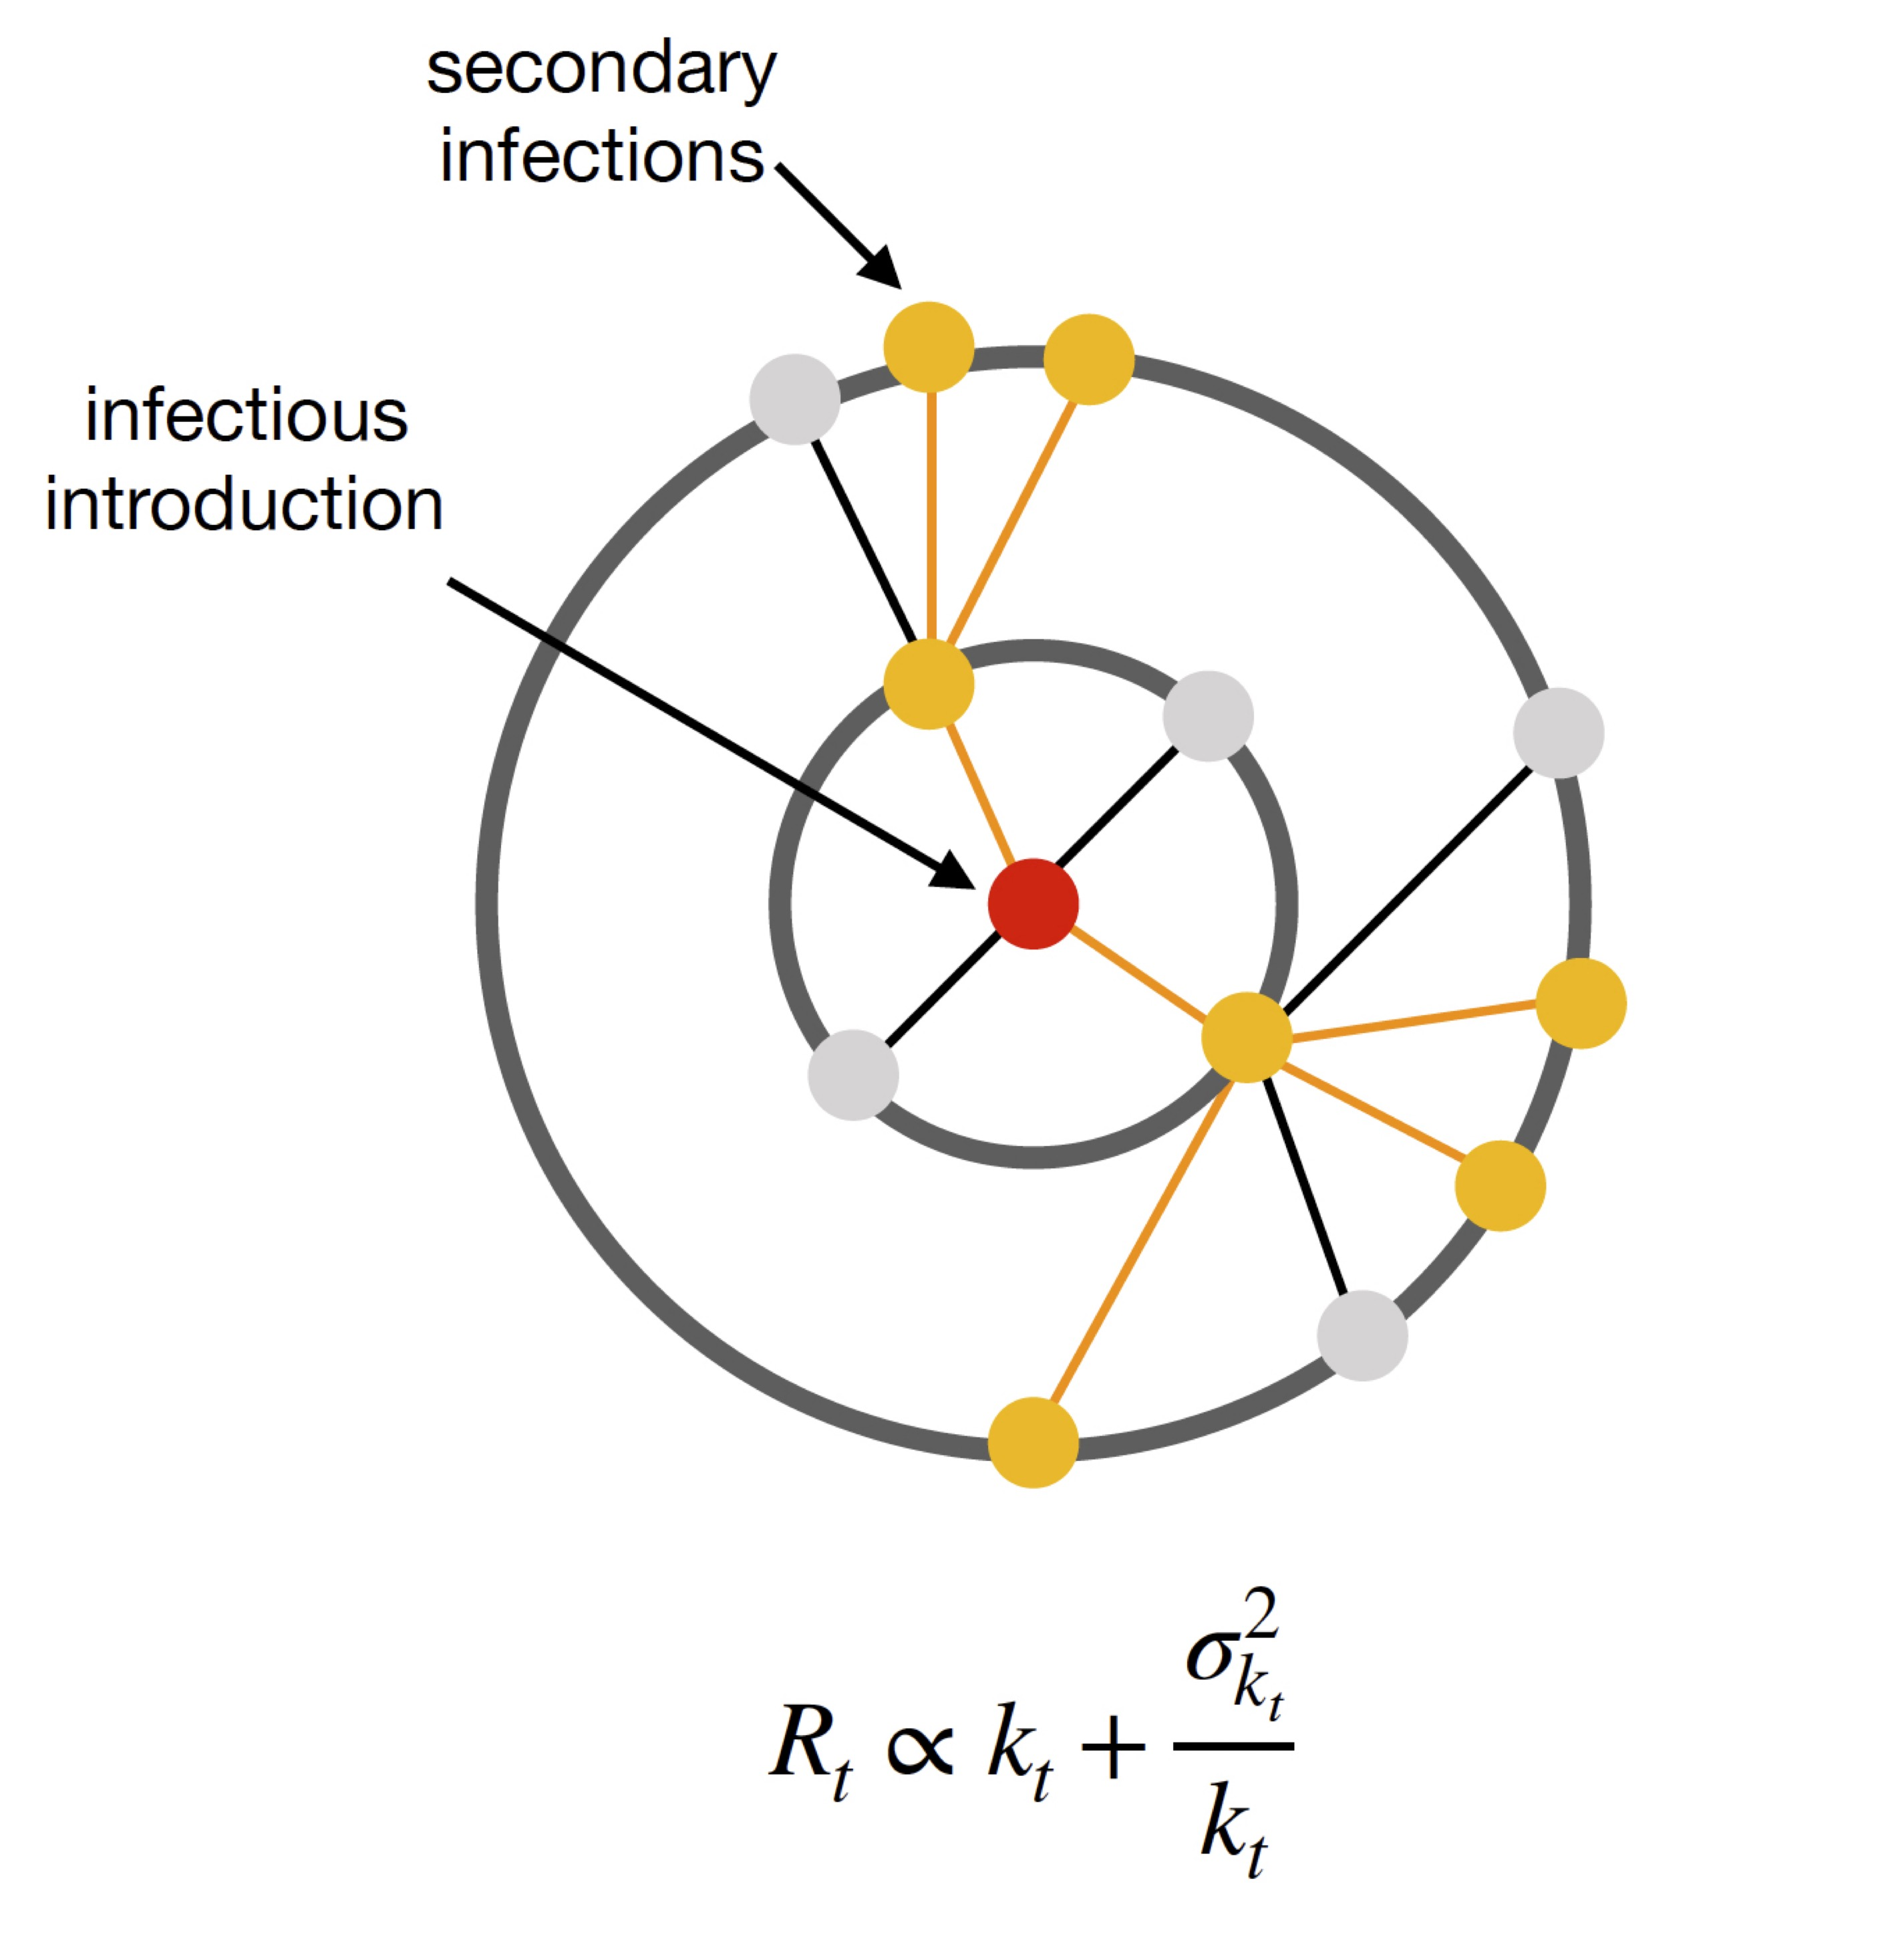
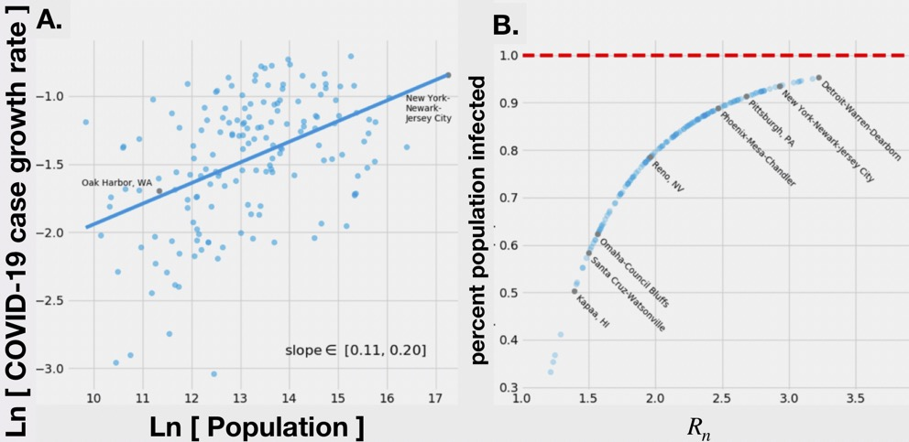
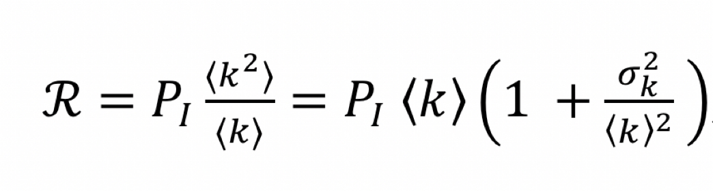
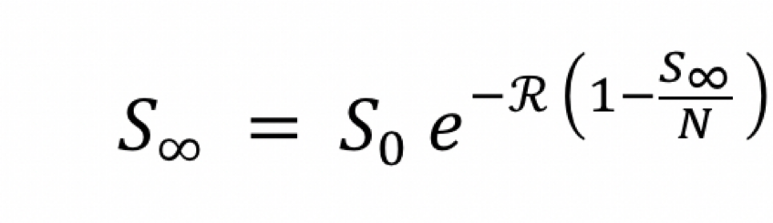
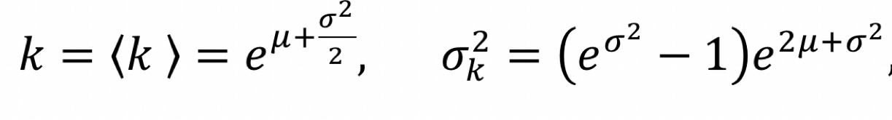
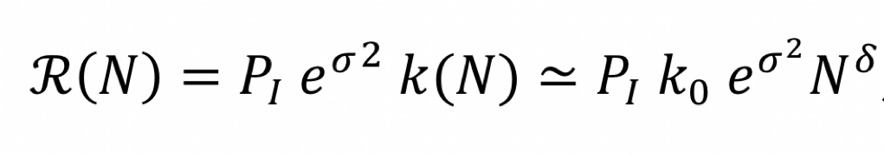
https://www.nature.com/articles/s42949-021-00030-0
Contagious Processes on Networks
For COVID-19:
Reproductive number:
Lognormal
size of the outbreak
vaccination rate:
$$P_{v}=1-1/R$$

Slide 34
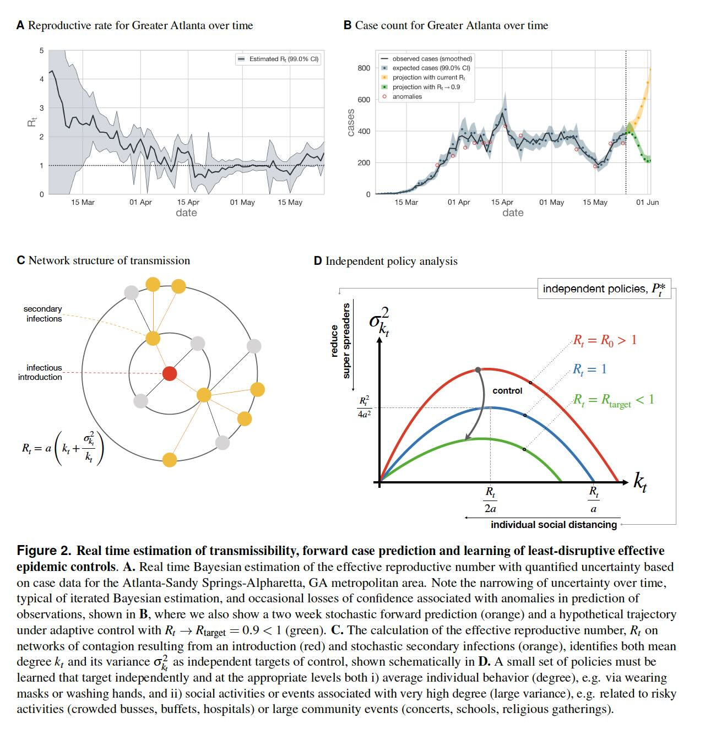

Slide 35
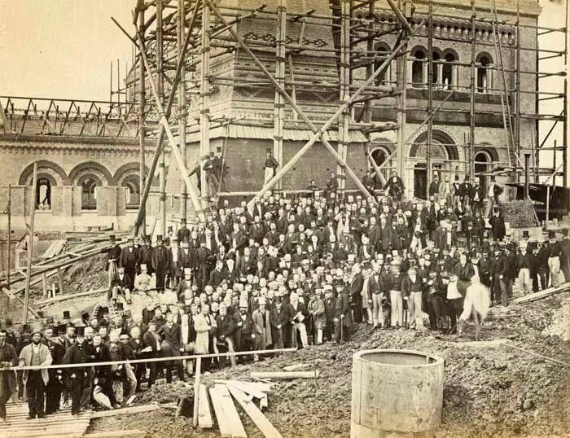
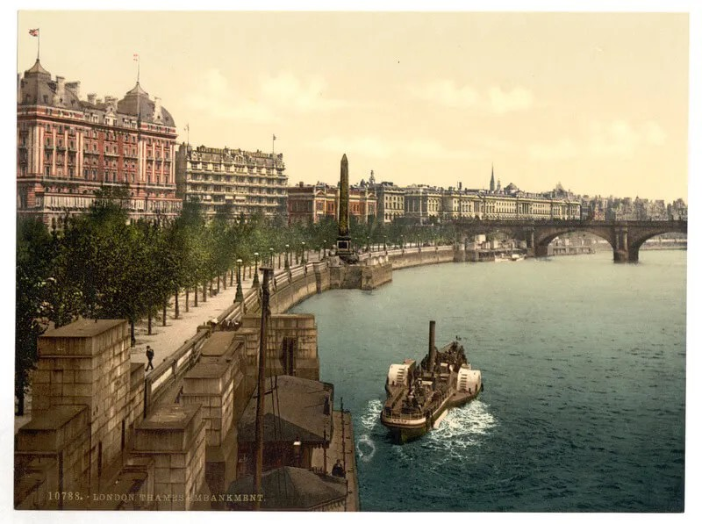
This led to major transformations of how we live in cities …
Sanitation works
River clean up, hidden pipes
https://heritagecalling.com/2019/03/28/the-story-of-londons-sewer-system/

Slide 36
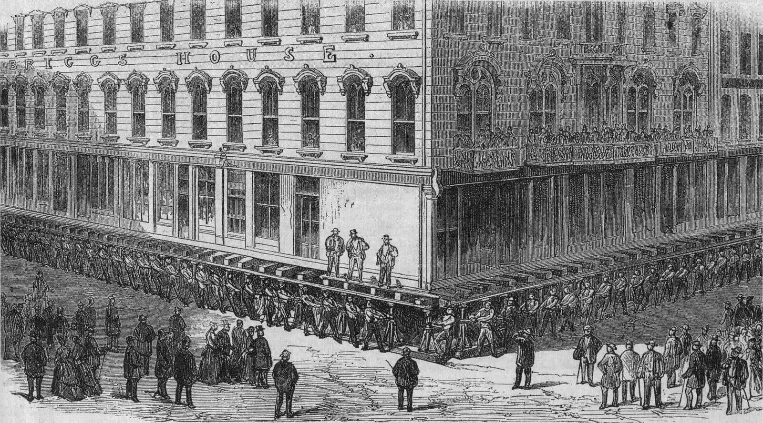
1854 cholera outbreak killed 6% of the population
6 feet 2 inches (1.88 m)
Chicago 1866
https://en.wikipedia.org/wiki/Raising_of_Chicago

Slide 37
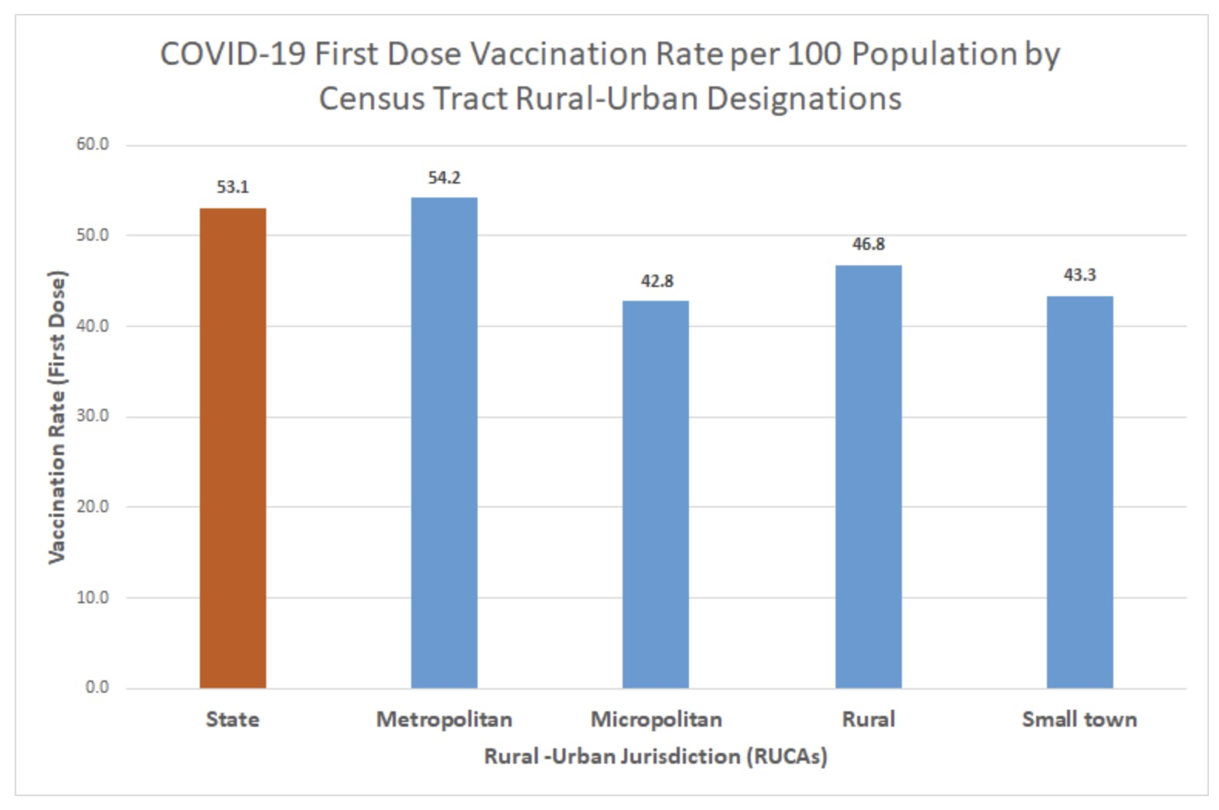
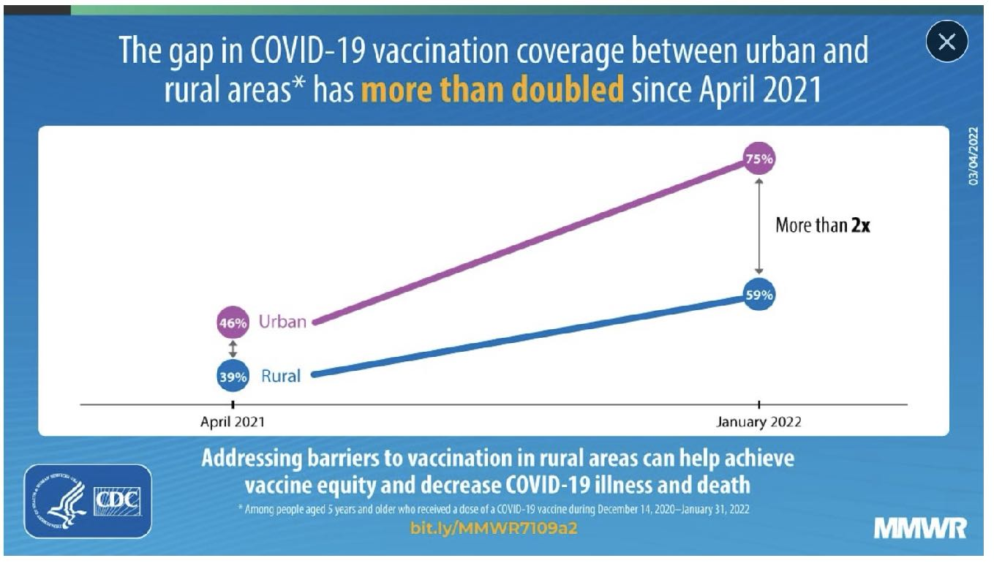
https://www.vdh.virginia.gov/content/uploads/sites/182/2021/09/Rurality.png

Slide 38
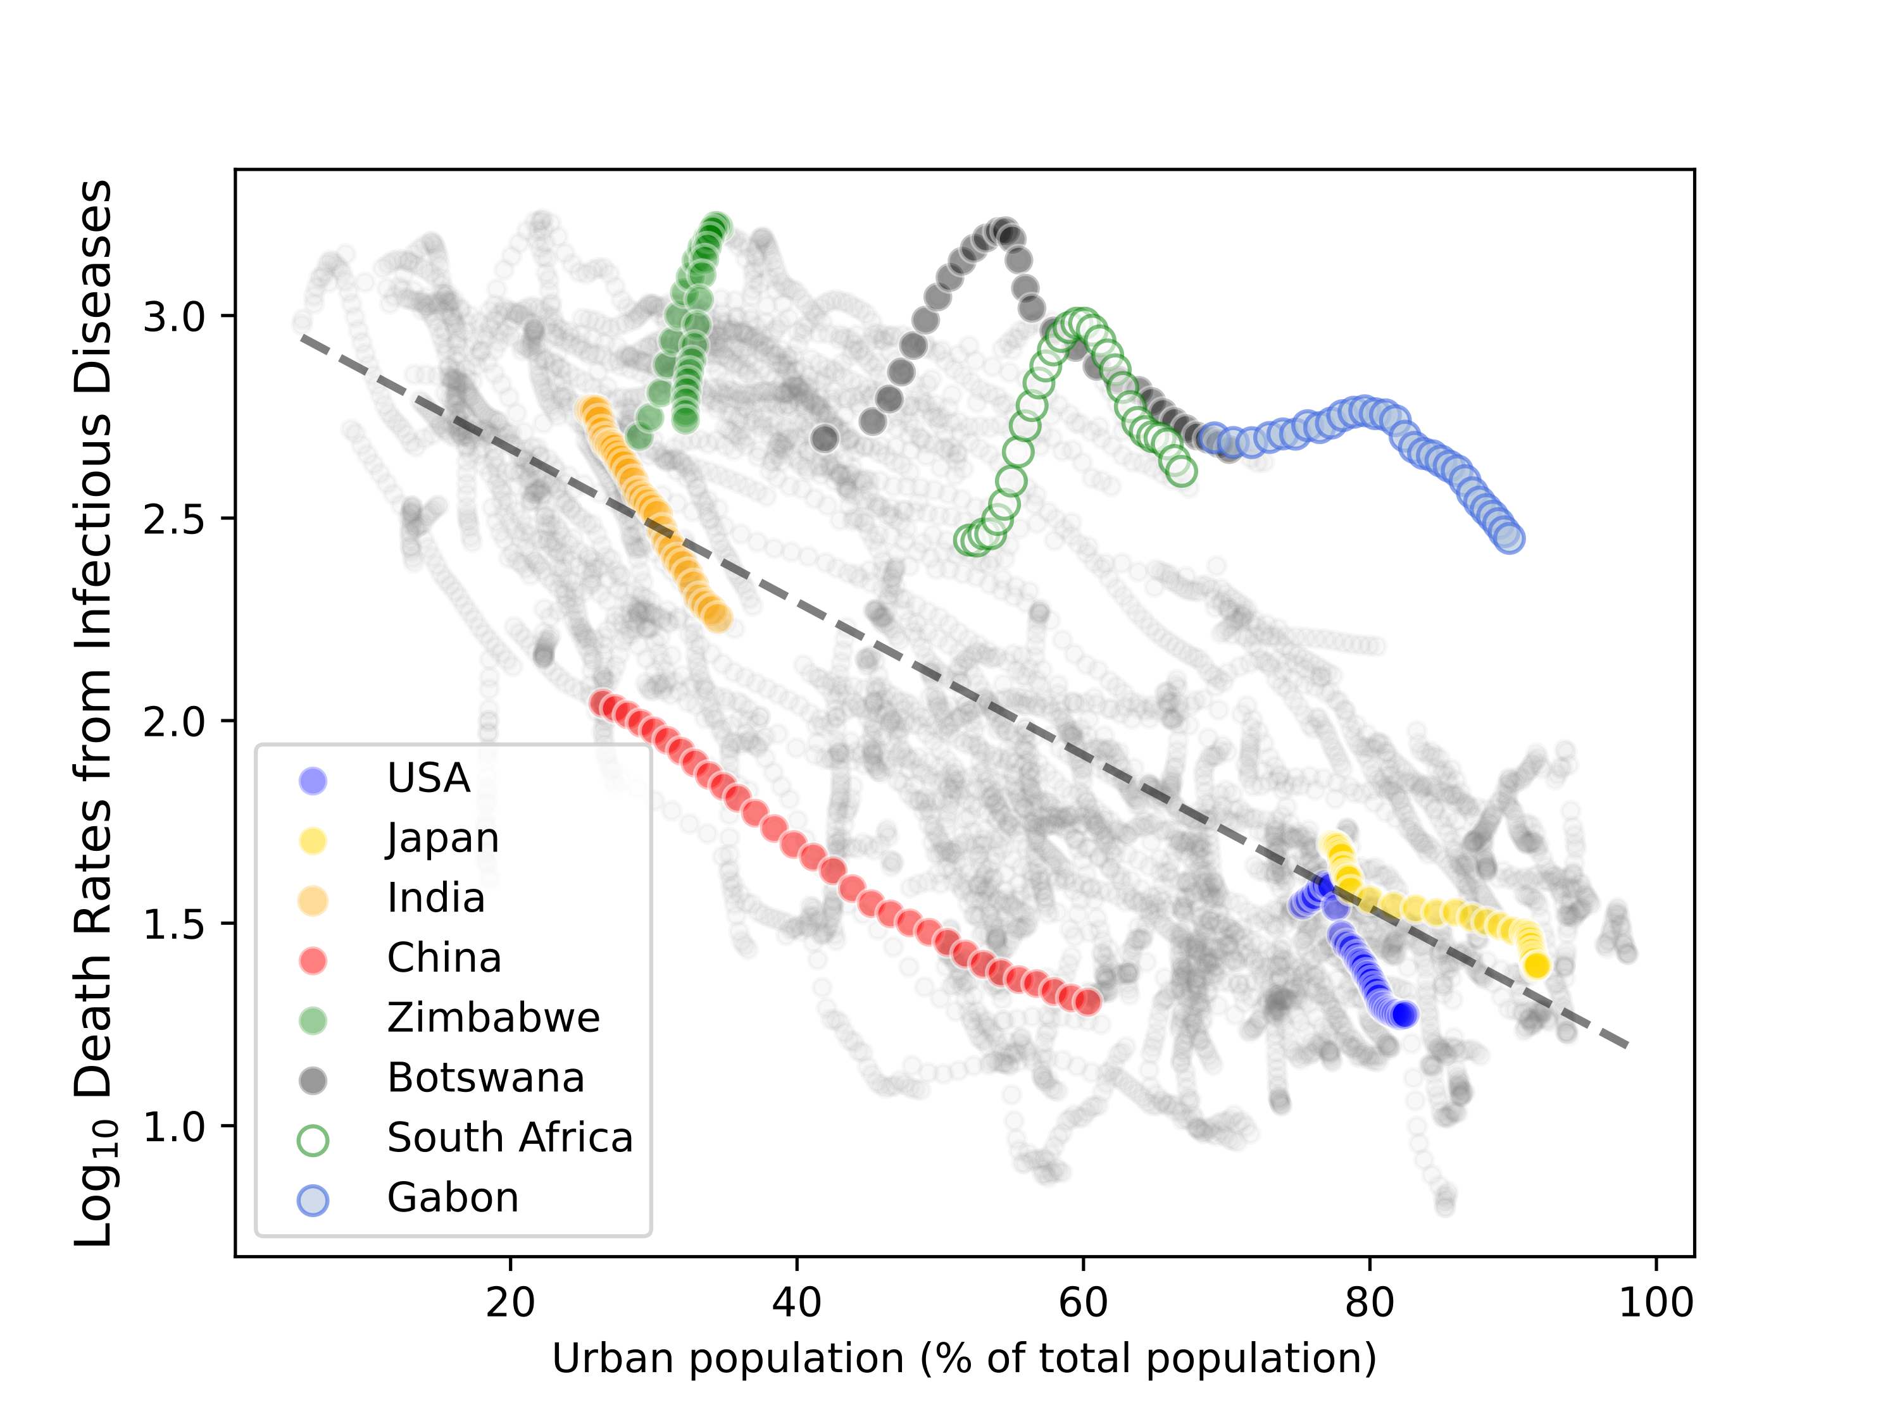
1% of population/year
4.4% decrease with each 1% urbanization
0.01% of population/year
covid
USA: 0.0135% (2019)

Slide 39
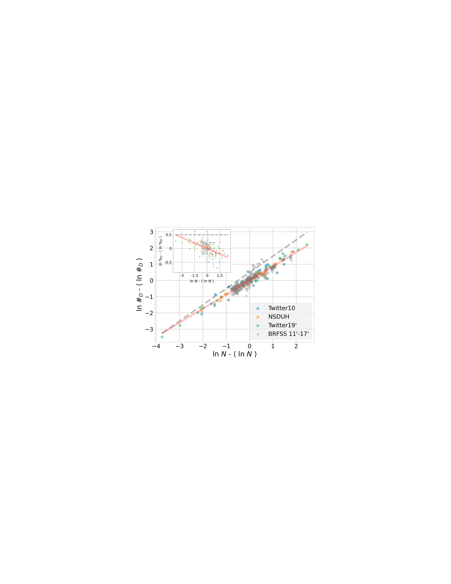
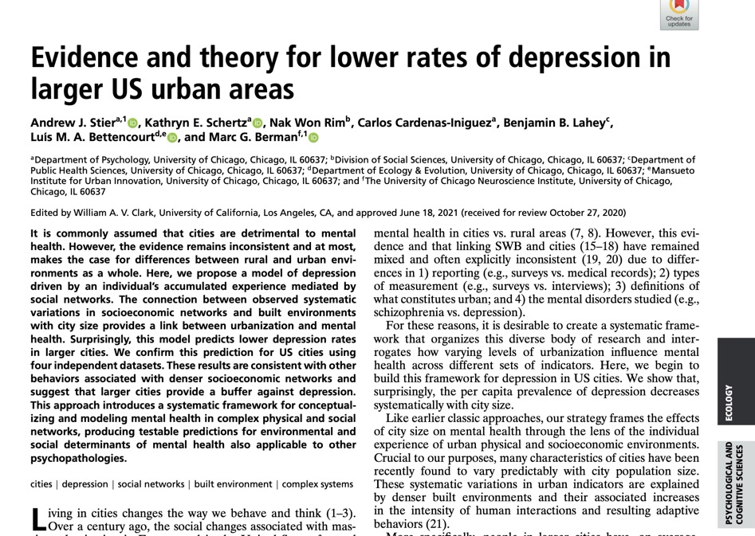
Mental Health
https://www.pnas.org/doi/10.1073/pnas.2022472118
Notes:
Depression is lower for people with more social contacts, it follows it should be lower in larger cities, as observed.

Slide 40
The pace of life accelerates
average rates of production and exchange per capita:
$$y(N)∼N^{δ}$$
speeds
$$[y]∼1/time$$
times between events “shrink” : $∼N^{-δ}$
quantifies some measures of overload

Slide 41
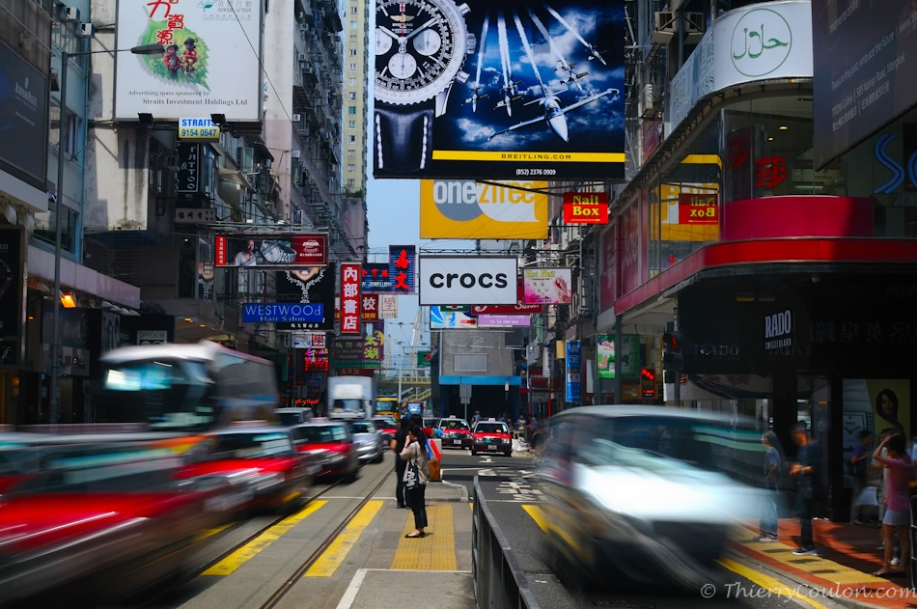
Notes:
Larger cities feel faster…

Slide 42
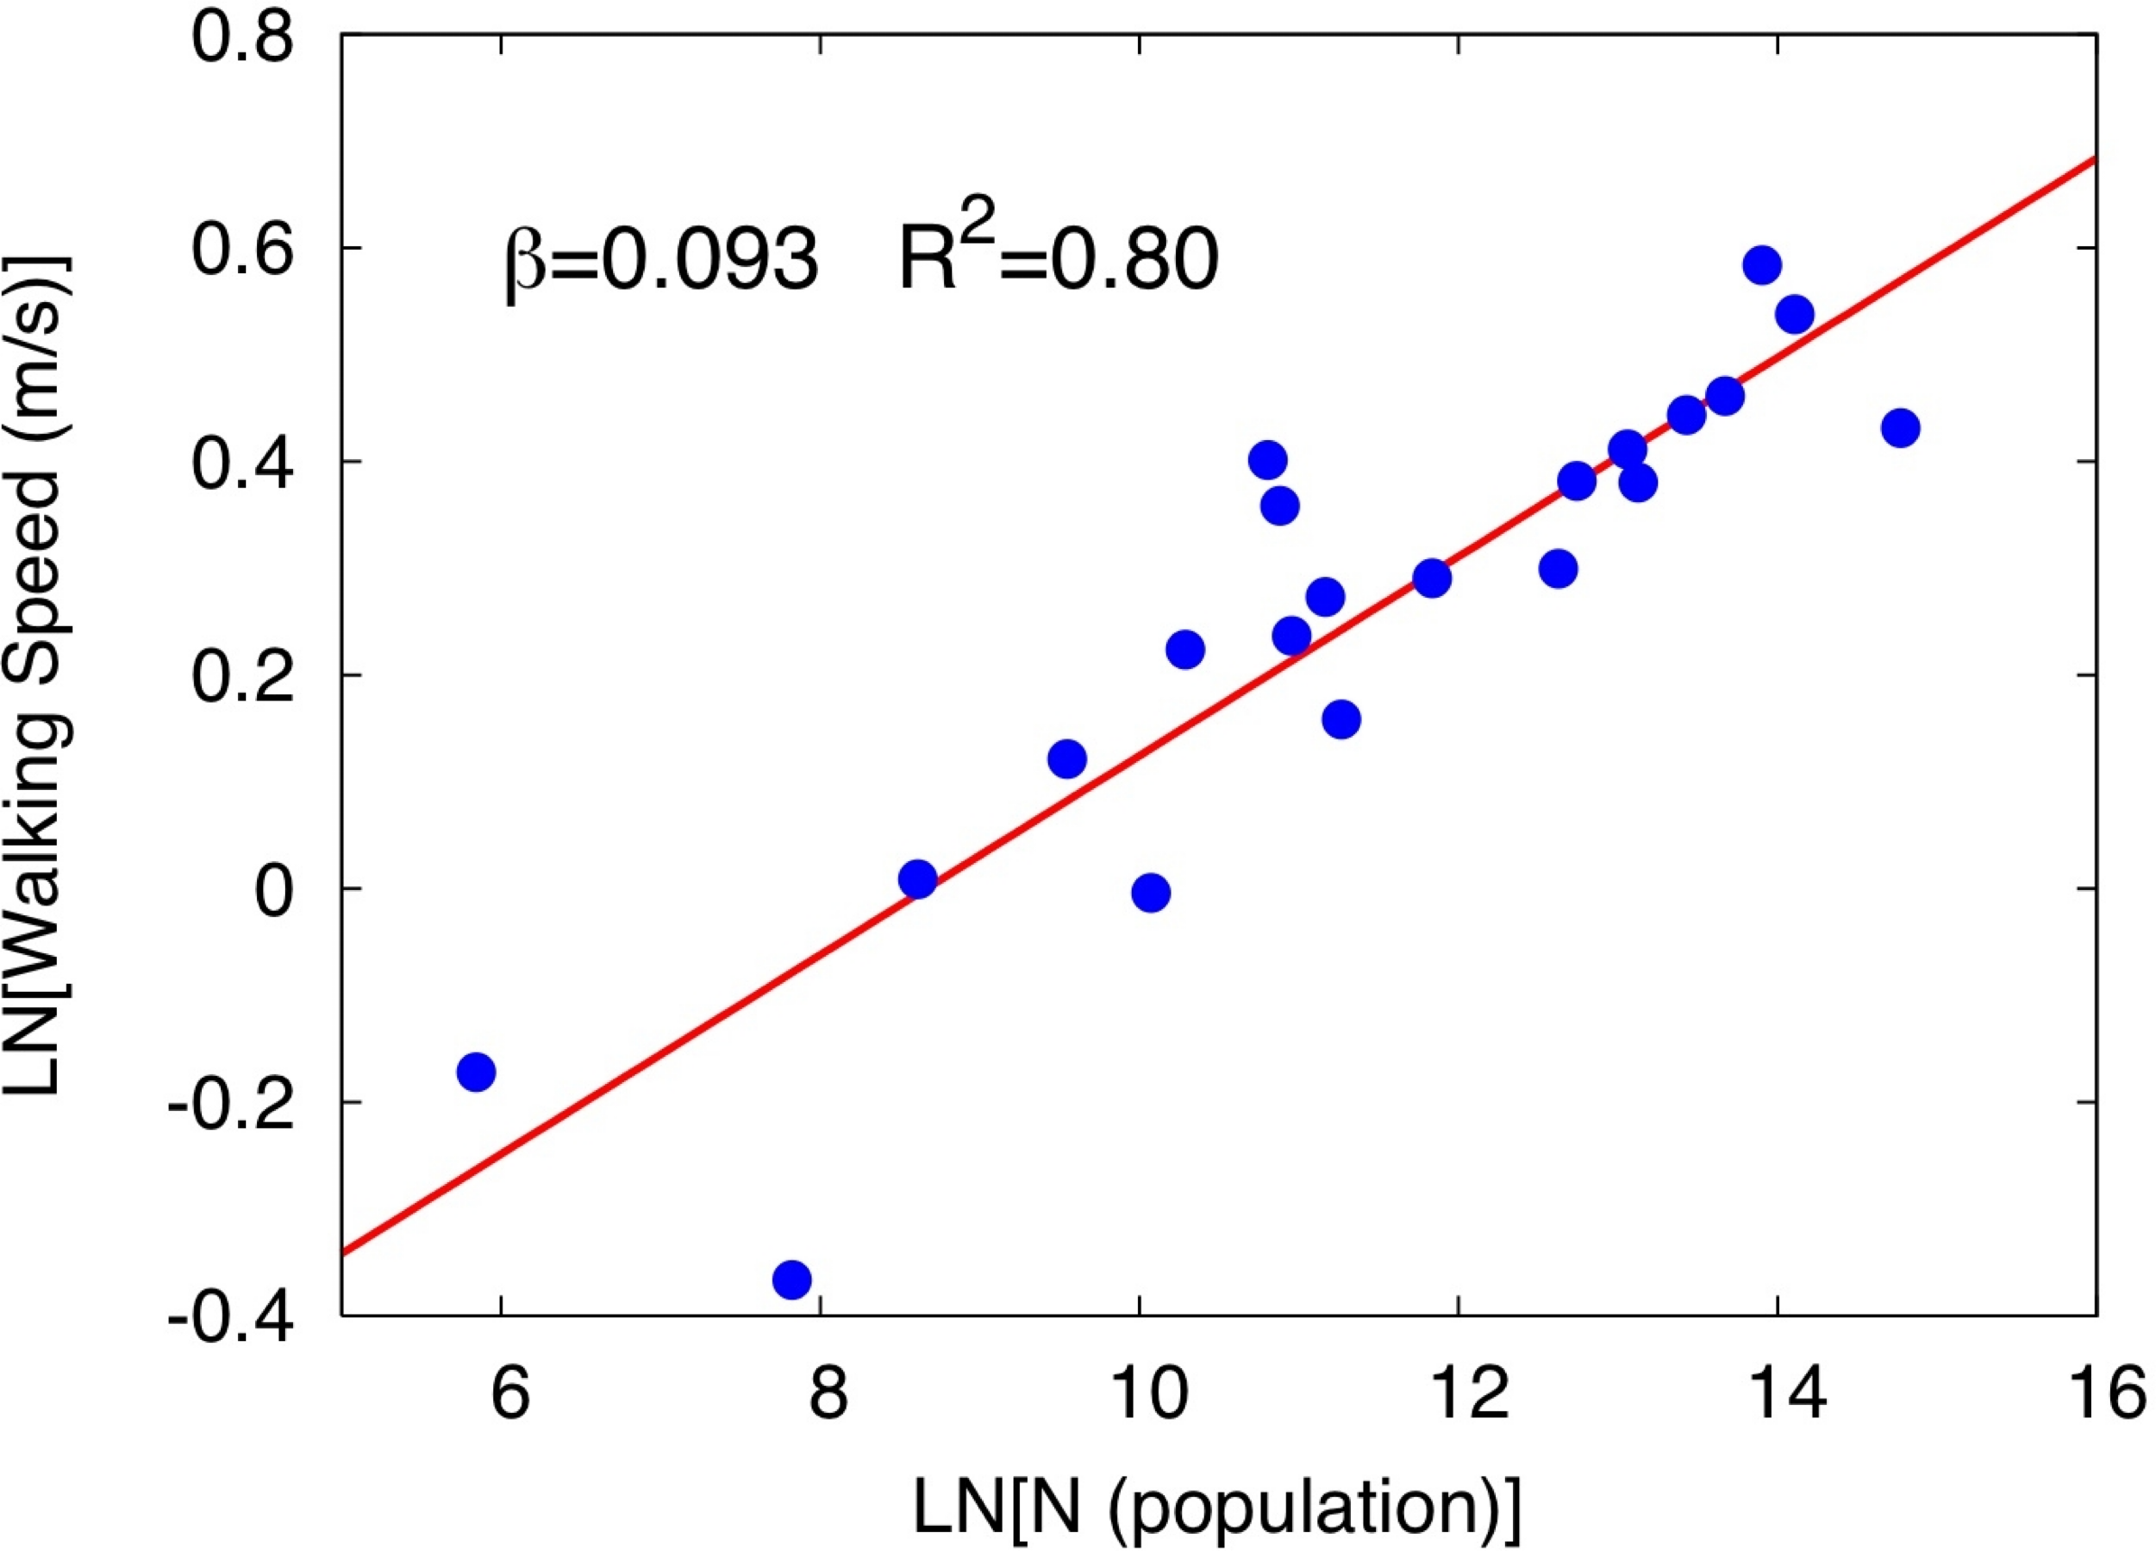
Walking Speed vs Population Size
$$y=Y_{0}N^{δ}∼mv^{2}$$
$$v∼N^{δ/2}=N^{1/{12}}$$
Notes:
People walk faster…

Slide 43
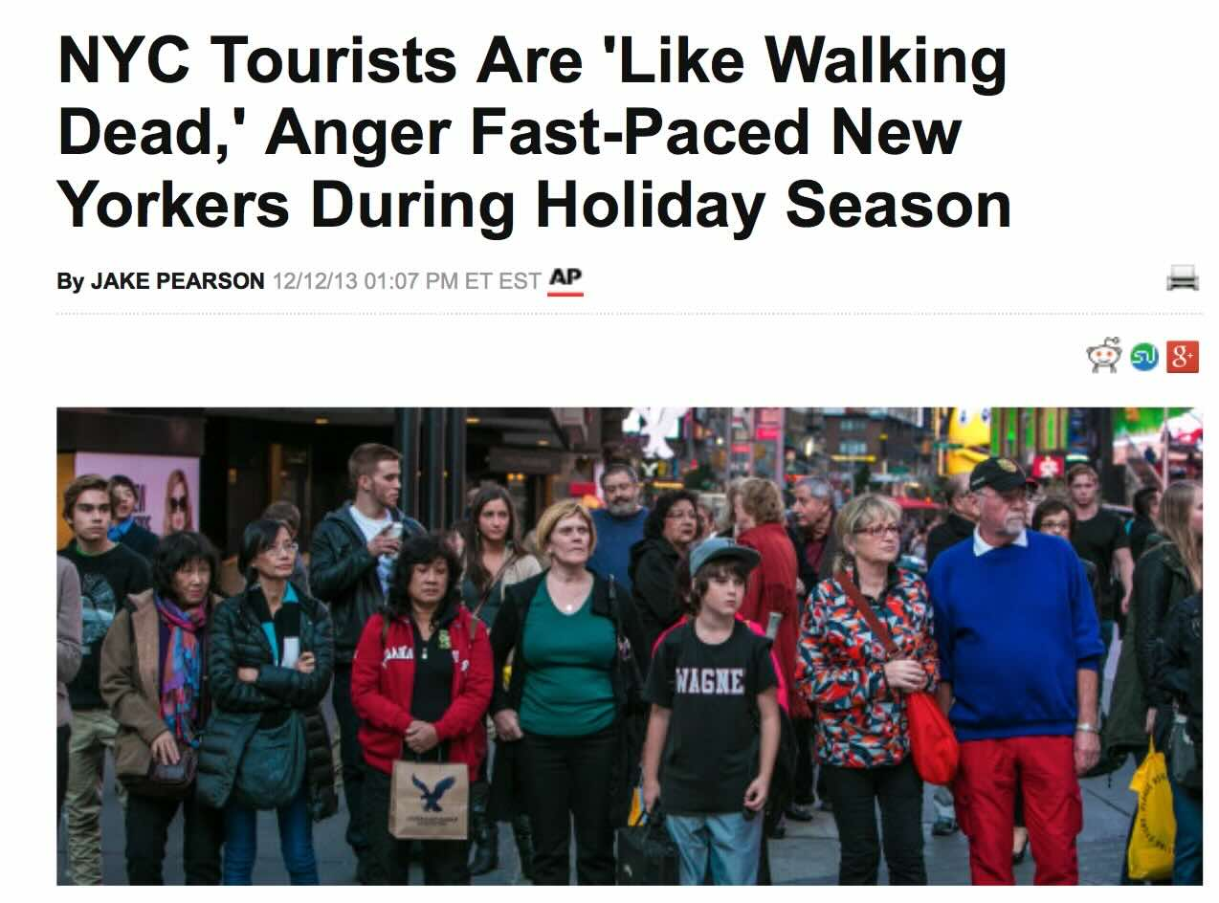
"They're like the walking dead, real slow," griped Dennis Moran, 46, a fire safety officer at a building in Times Square and a native New Yorker. "They have this unnatural habit of stopping in the middle of the sidewalk."
credit: Huffington Post
Notes:
Visiting people (tourists) to larger cities are just too slow. It would be an interesting experiment to see if such people adapt and sped up over time, as they spend time in larger cities. How long does that take?

Slide 44
Fractal Dimension of
Built Spaces

Slide 45
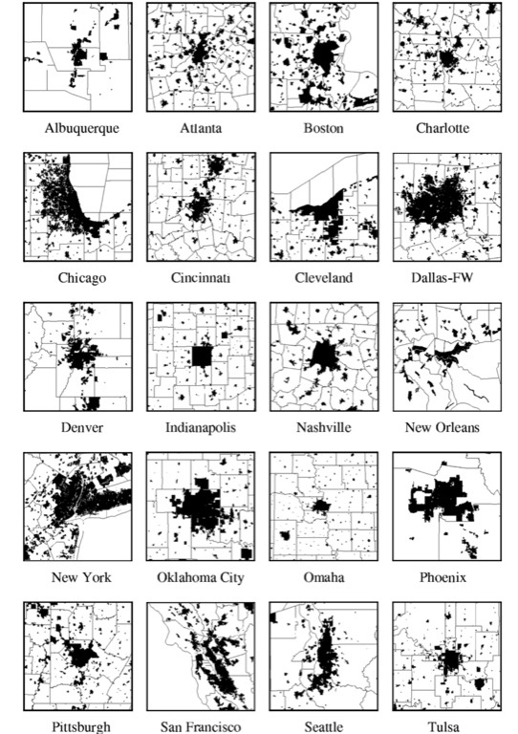
Shapes of built spaces of cities
1990s
Fractal Dimension
$$D_{f}=\frac{log\frac{M(R)}{M_{0}}}{log\frac{R}{R_{m}}}$$
$$M(R)=M_{0}R^{D_{f}}$$
Use it for built area and population
$${D_{f}}^{N}=\frac{log\frac{N}{N_{0}}}{log\frac{R}{R_{m}}}$$
$${D_{f}}^{A_{n}}=\frac{log\frac{A_{n}}{A_{0}}}{log\frac{R}{R_{m}}}$$
$$\frac{{D_{f}}^{A_{n}}}{{D_{f}}^{N}}=\frac{logA_{n}-logA_{0}}{logN-logN_{0}}=\frac{ΔlogA_{n}}{ΔlogN}=\frac{5}{6}$$
another way to measure urban scaling exponents
Notes:
Fractal dimensions of built spaces have been interesting to geographers and complex systems researchers for decades: Scaling predicts that the ratio of fractal dimensions is a scaling exponent, specifically the ratio of the fractal dimension of built up area to population is 5/6 because it is in fact the derivative of the former scaling law vs population.

Slide 46
Slums and Informal Settlements
Have incomplete infrastructure networks, can use these ideas to identify where and how much to do

Slide 47

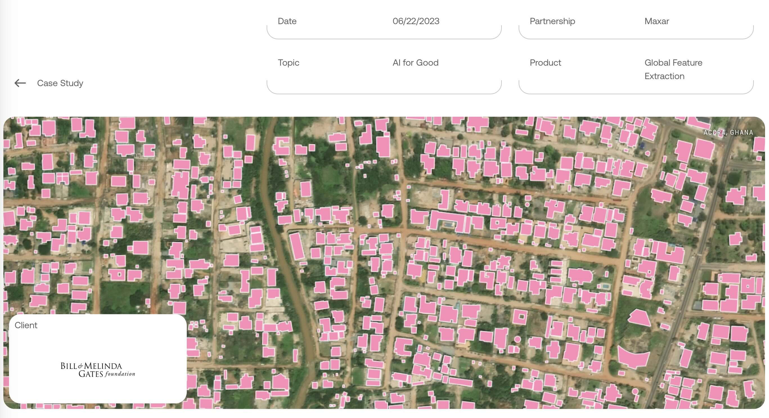
https://www.ecopiatech.com/resources/case-study/mapping-sub-saharan-africa-to-enable-life-saving-humanitarian-aid

Slide 48
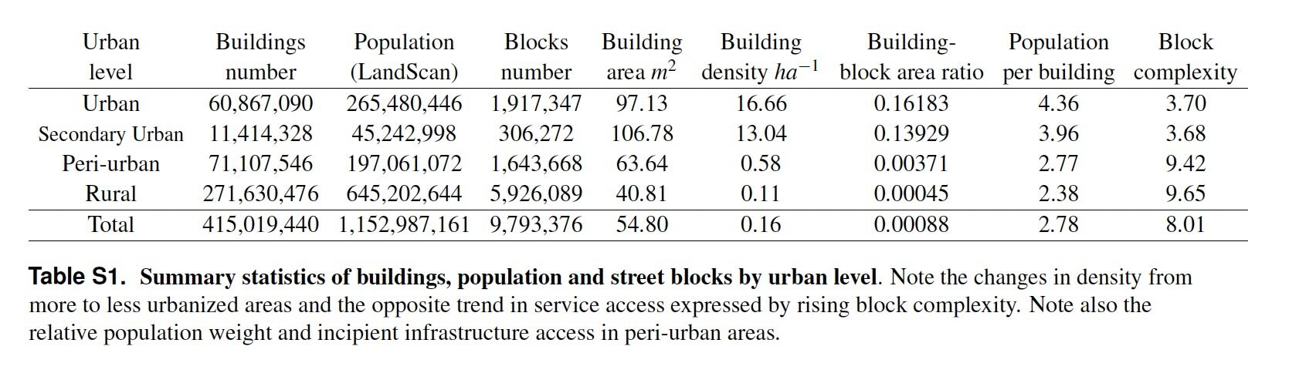



Summary Statistics of Population, Blocks, and Buildings

Slide 49
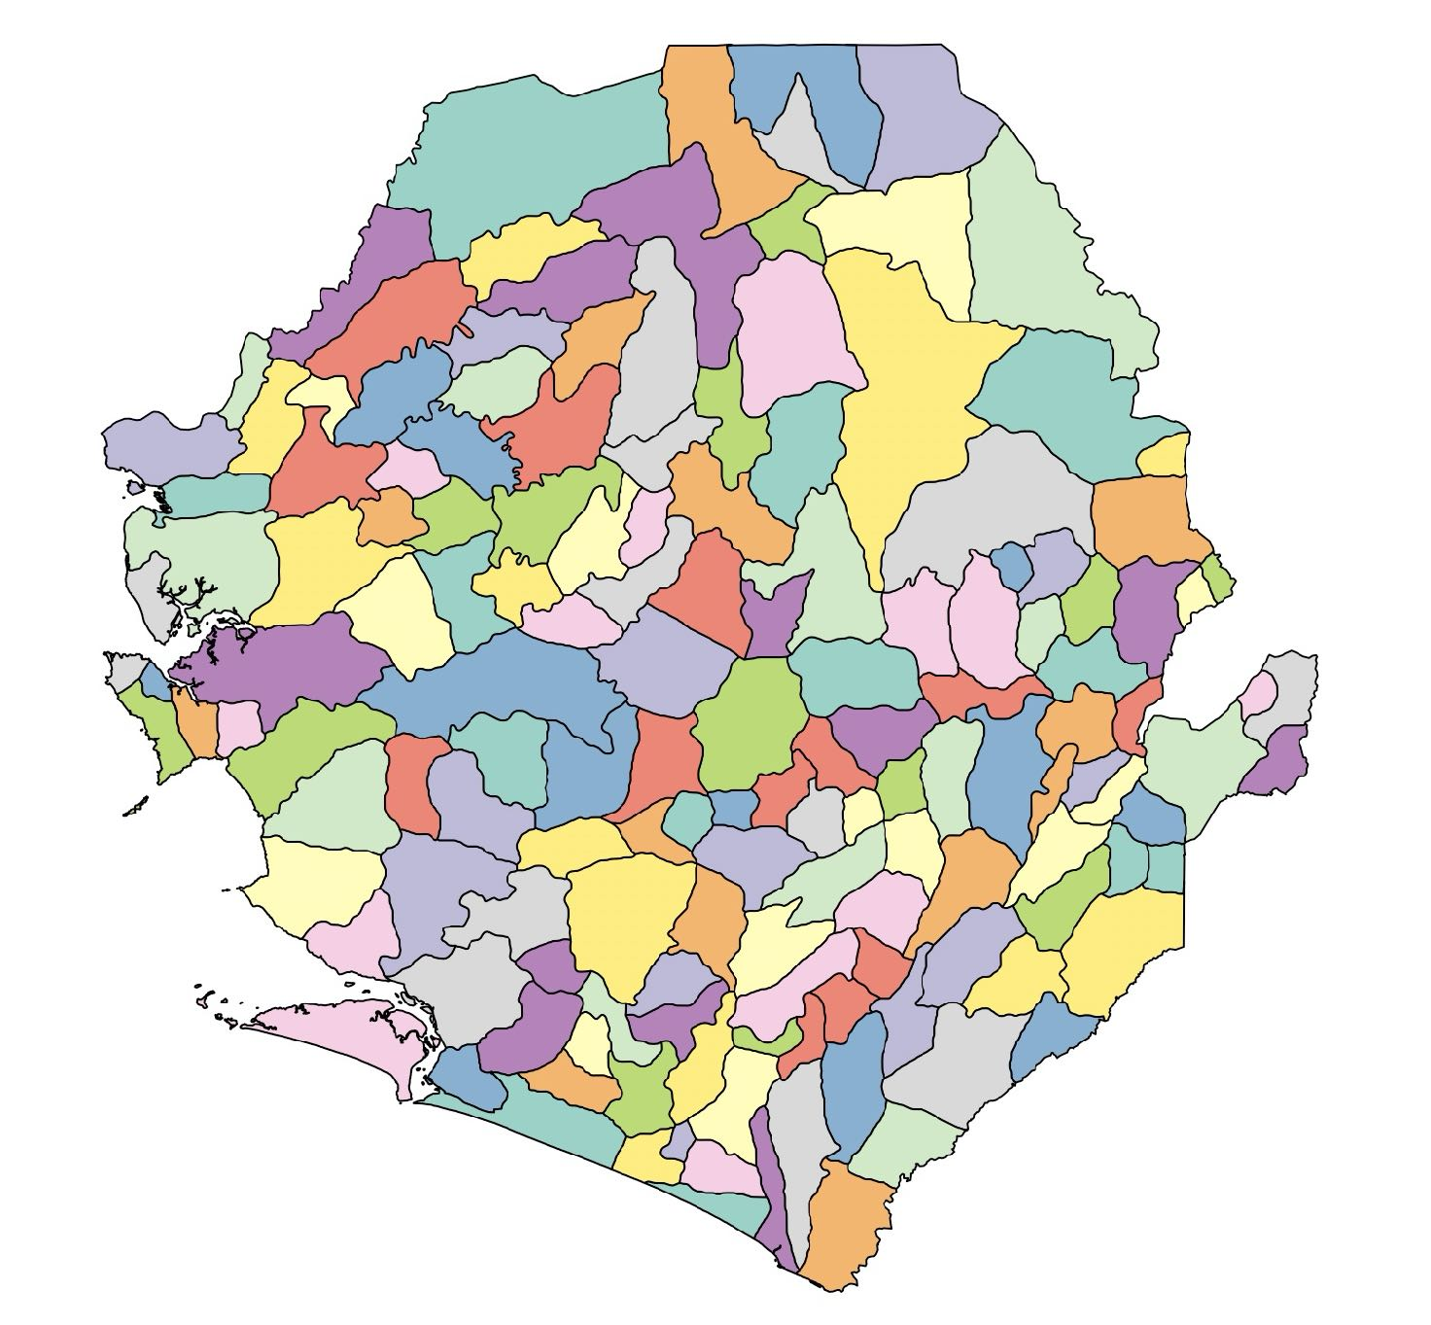
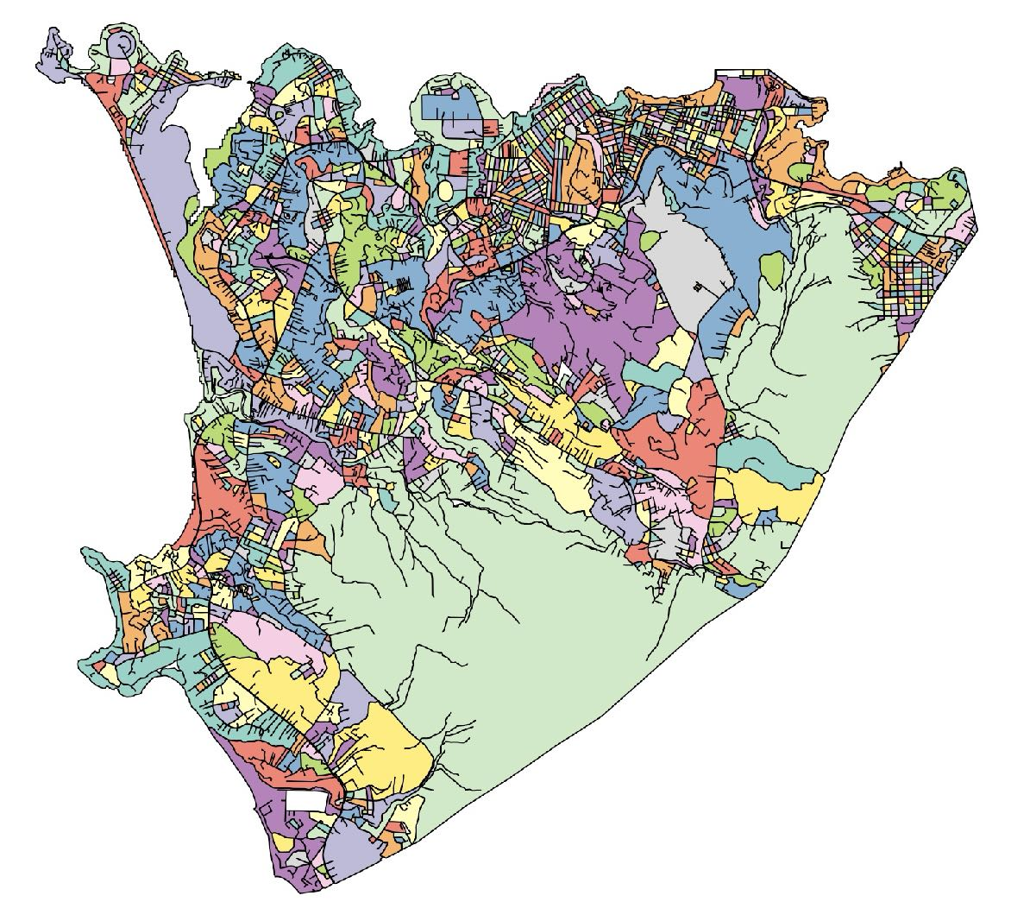
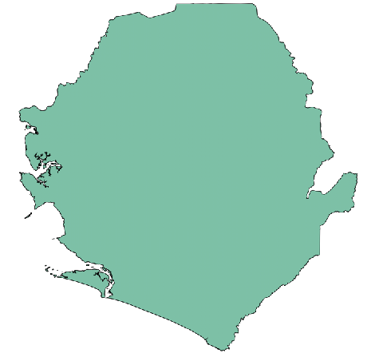
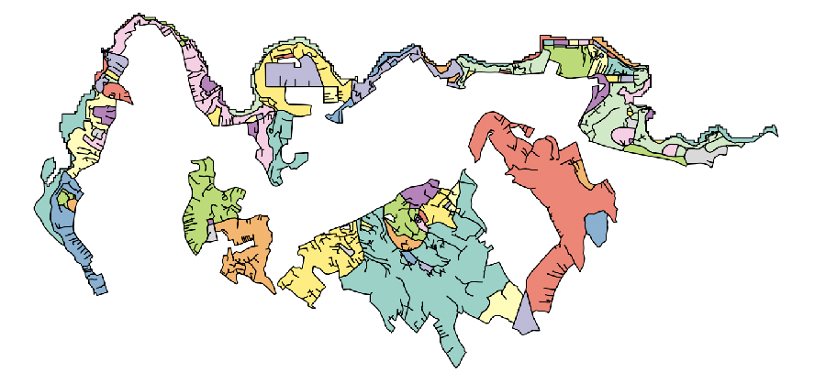
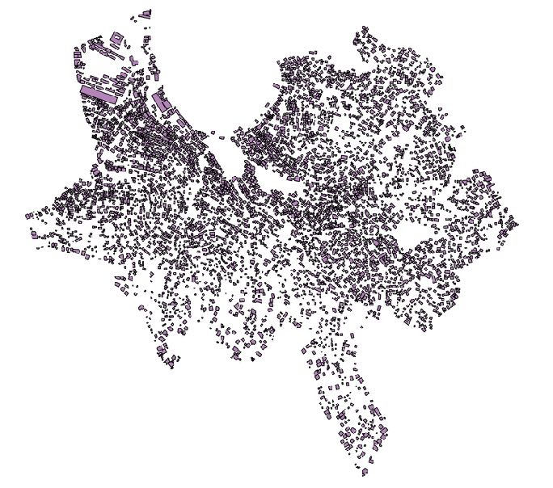



Understanding settlements from global to local scales
a global map (of cities) neighborhood by neighborhood
Kroo Bay
Sierra Leone
Dwarzark
Freetown
Building footprints
“Block” unit

Slide 50

A network (graph theory) model to identify disconnected parcels and underserviced city blocks
https://www.science.org/doi/10.1126/sciadv.aar4644
Notes:
Slums are places (among other things) where the networks of the city (infrastructural and socioeconomic) have not yet formed, but are only latent. We can measure the lack of infrastructure to buildings using topological methods.

Slide 51



A disconnected block in a South African Township

Slide 52


Detecting informality down to the street block
Building footprints
Dwarzark
“Block” unit

Slide 53

Mapping informality and population in Freetown
Spectrum of informality
requires
major
interventions
Total Population: 880,537
requires
minor extensions
of streets+services
© University of Chicago

Slide 54

Notes:
Connectivity can be expanded to connect each building…

Slide 55

https://millionneighborhoods.org
About 150 km of new accesses are needed in Kibera.
Notes:
And estimate the (minimal) length of extra infrastructure to be built…

Slide 56

Every city, town and hamlet: every block
New block level data worldwide

Slide 57
A large number of interconnected phenomena
From behavior and cognition
to infrastructure and services
to socioeconomic wellbeing and outcomes
are understood and predicted by a theory of cities as complex networks
This kind of theory will allow us to predict characteristics of cities throughout history and across diverse contexts
What about exceptions? Inequality? Growth? Information?

